Slide 1
How to use the City of Albuquerque
Campaign Finance Reporting Site
www.campaignfinance.cabq.gov

Slide 2
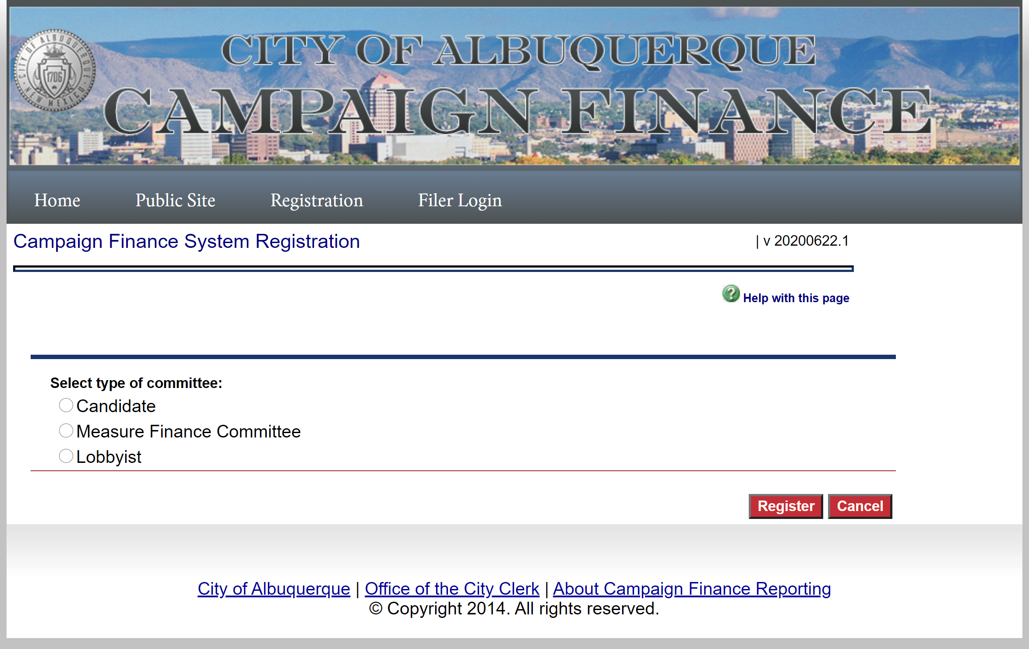
Registration
Click on the Registration tab and then select type.
After you’ve selected a type, click on “register.”

Slide 3
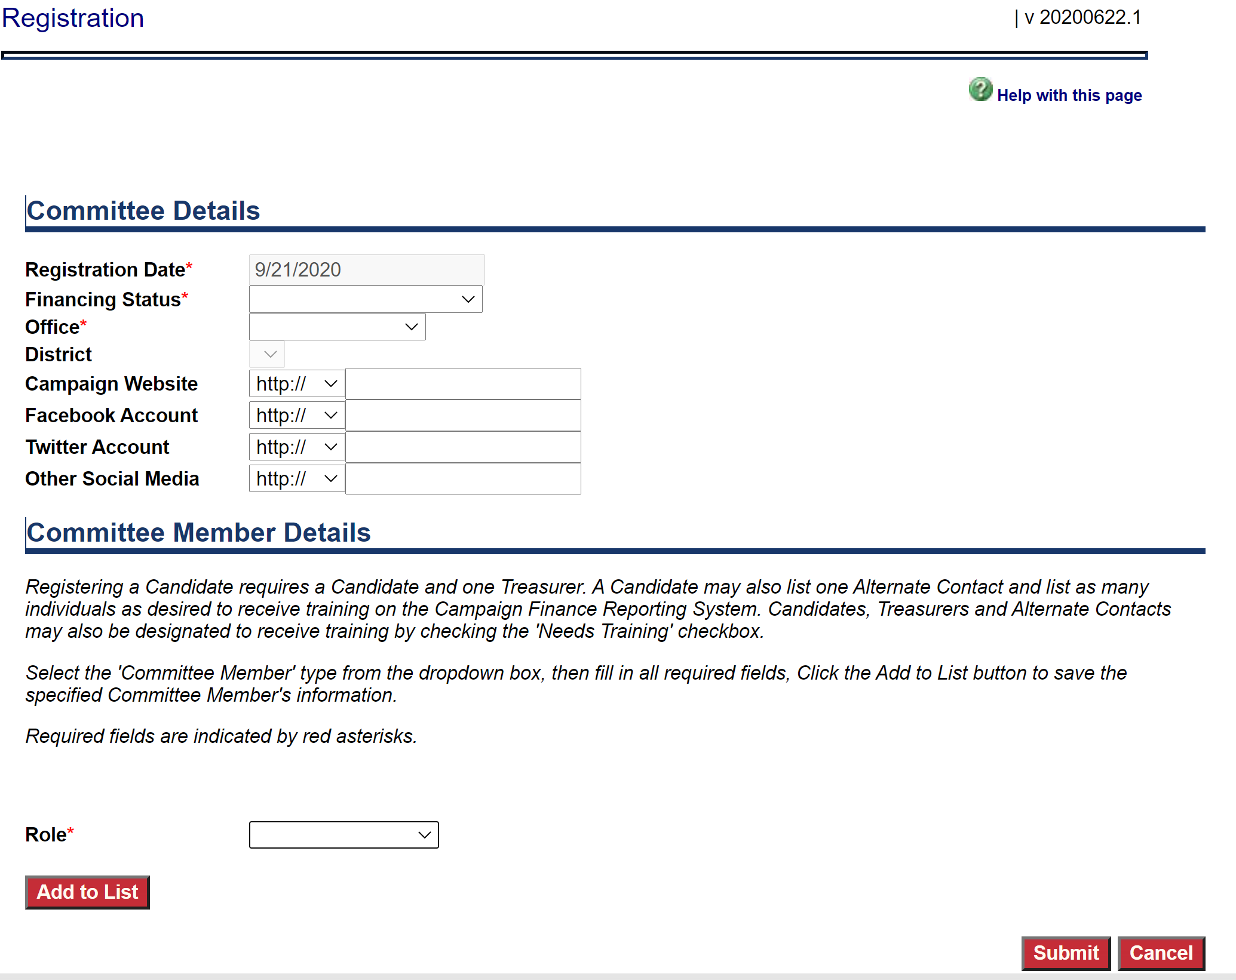
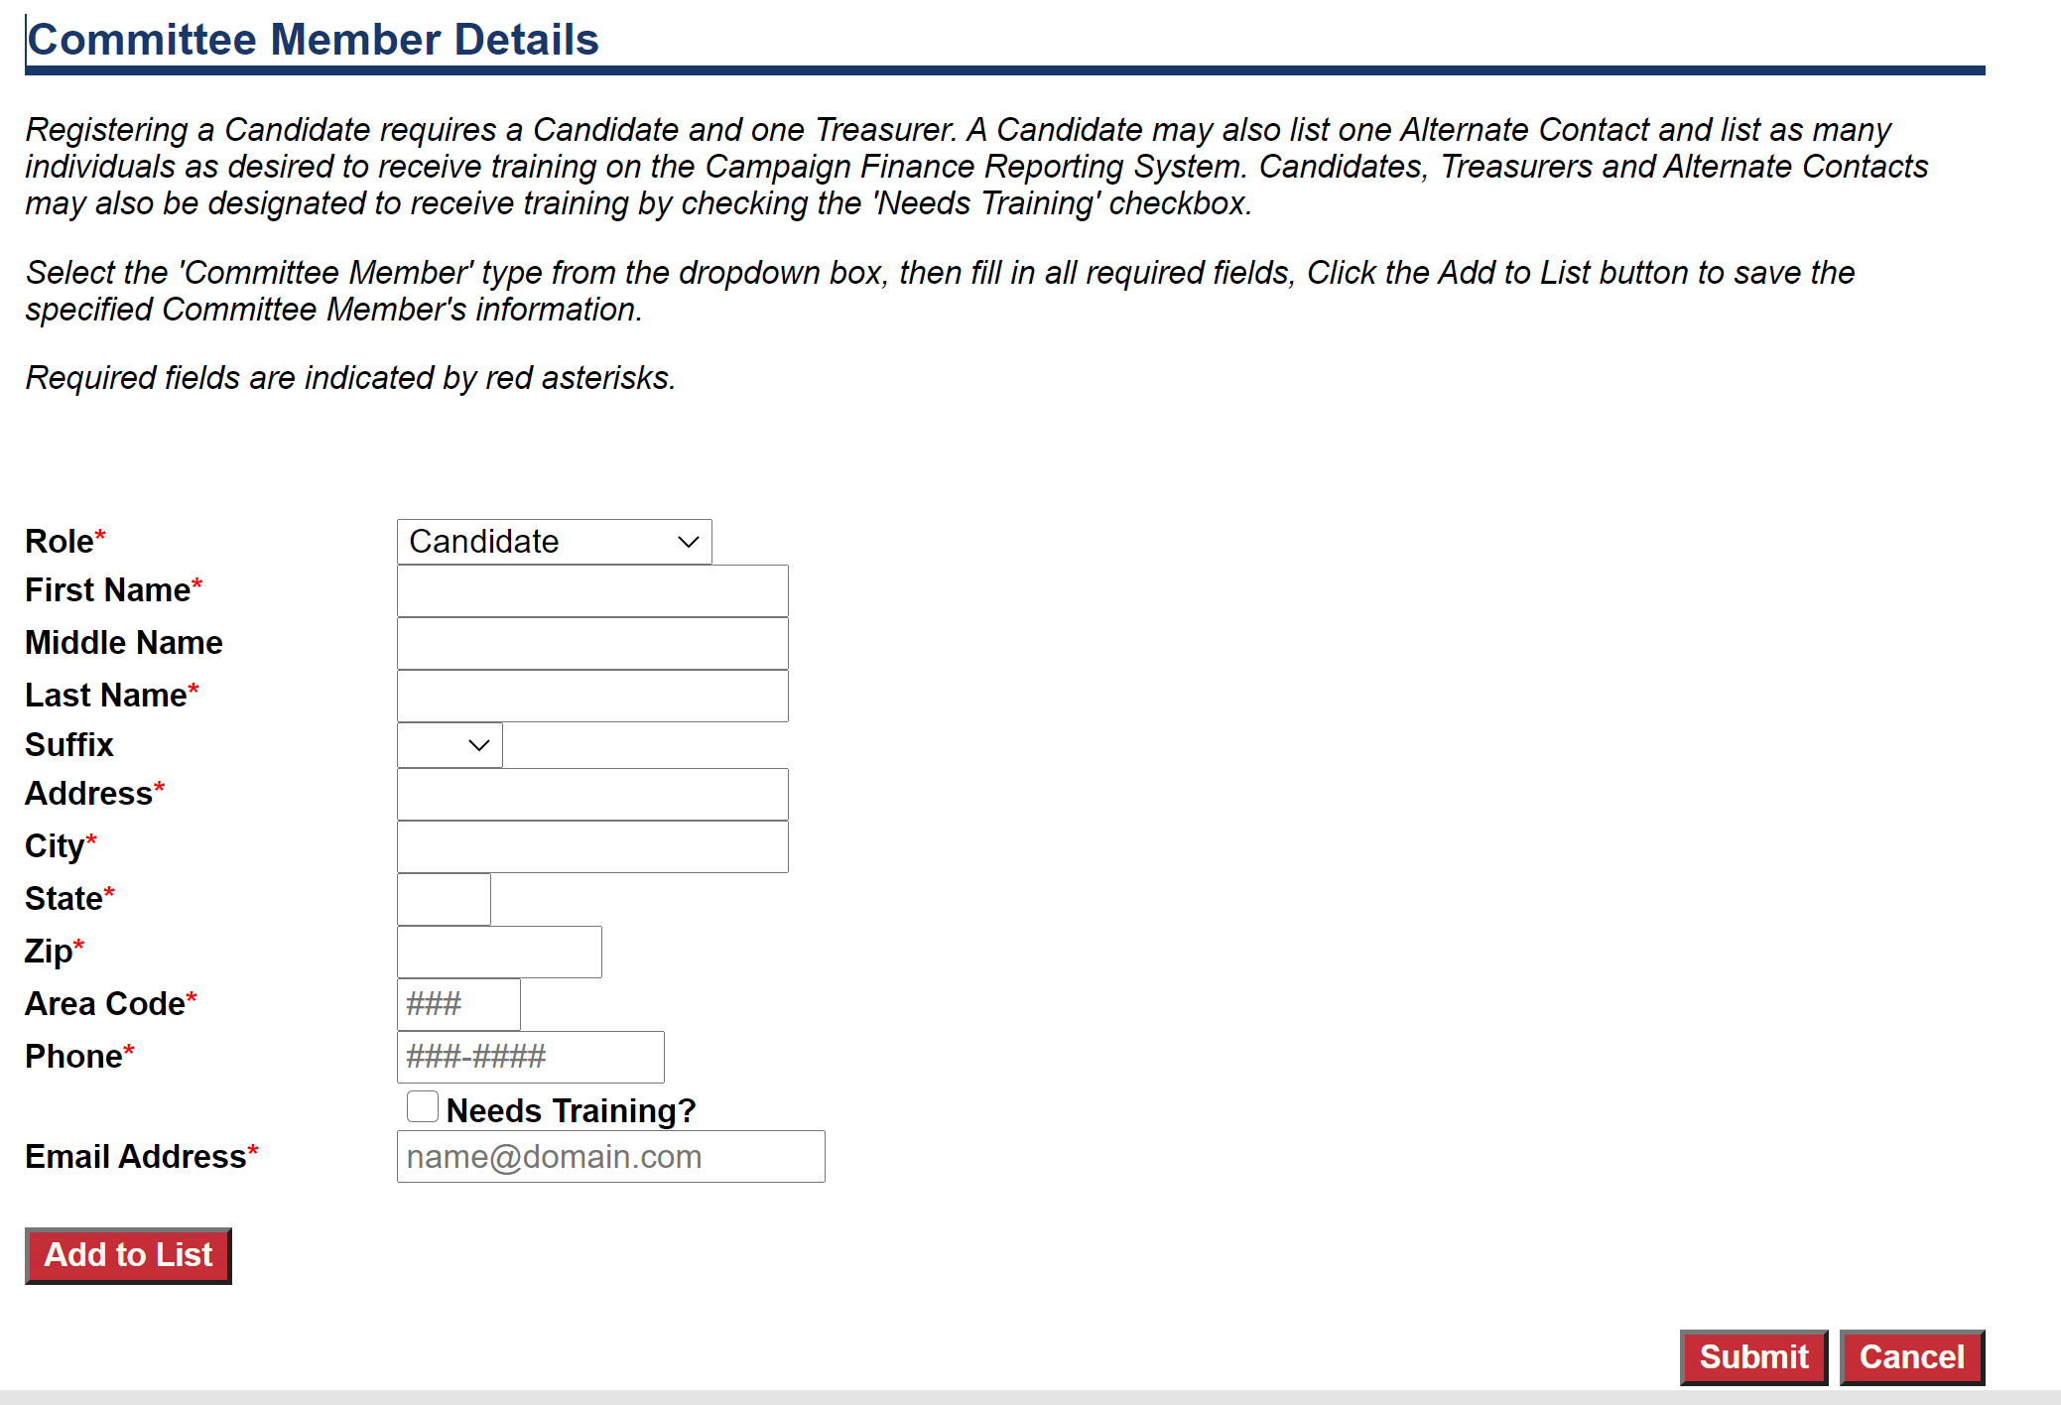
Registration as a Candidate will require selection of type of financing, and which office the candidate is seeking. Details of the candidates social media and website are not required.
Registration as an MFC will require a Committee name, purpose, and email account.
Candidates must enter member details for the Candidate and a Treasurer. Alternate contact information can be entered under roles as well.
MFCs must enter member details for Chairperson and a Treasurer. Alternate contacts may be entered under roles as well.
Click “Add to List” when you finish entering each role. Click “Submit” when you have entered all required roles.

Slide 4
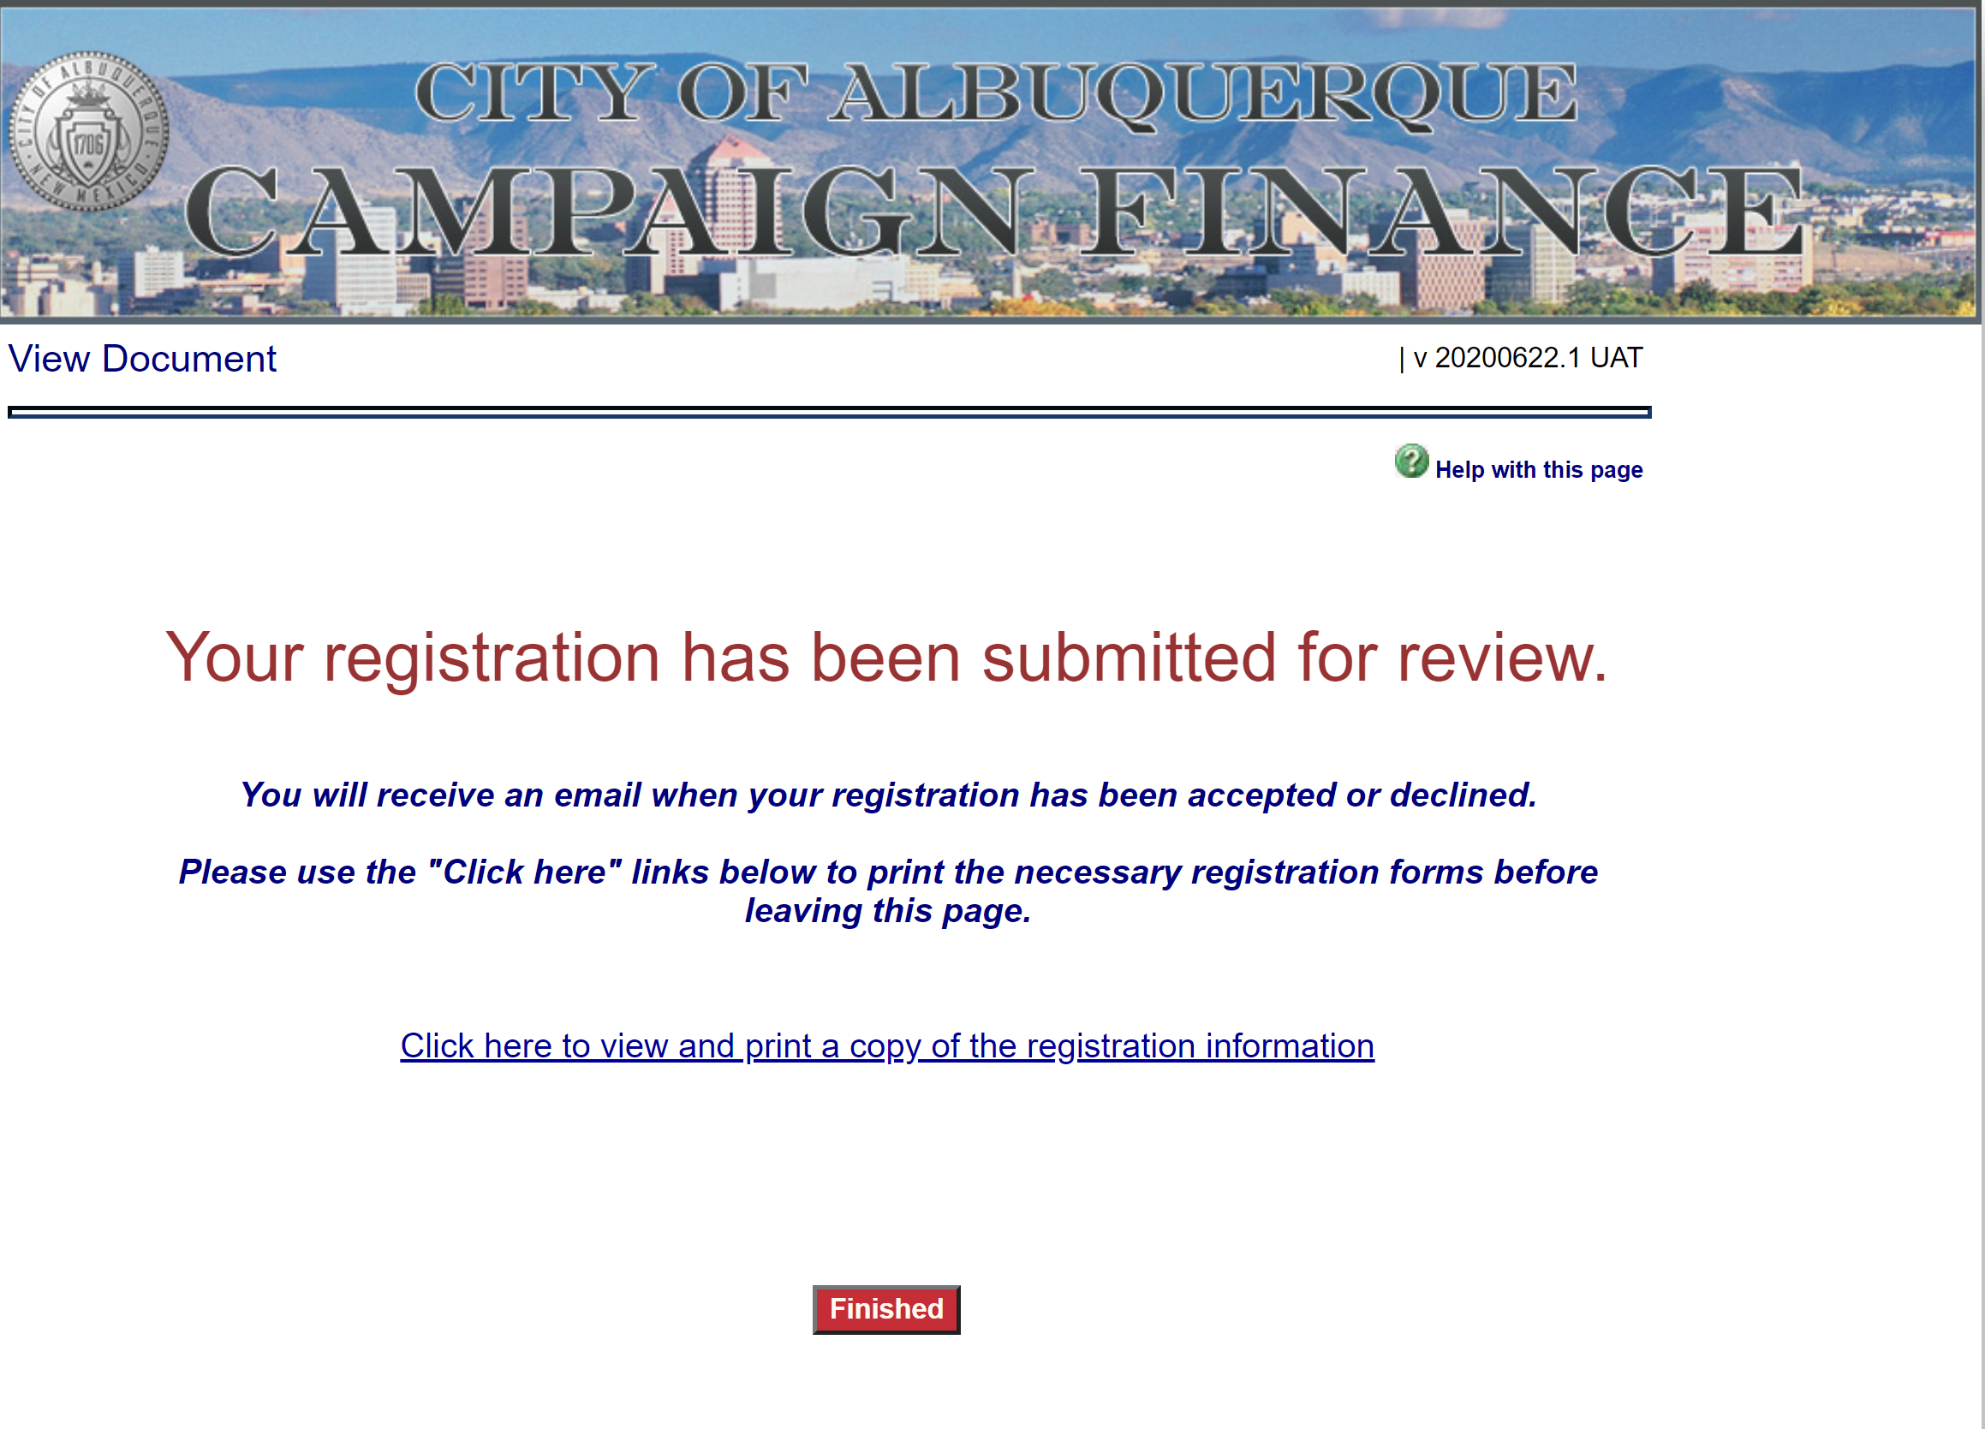
Once you’ve finished entered your committee details and roles, your registration will be submitted to the City Clerk’s Office for approval.
Once the City Clerk’s Office has approved your registration, any roles that were entered with corresponding email addresses will receive an email notification along with a User Name and temporary PIN.
If you have any questions at this point, or would like to check on your registration, please email elections@cabq.gov

Slide 5
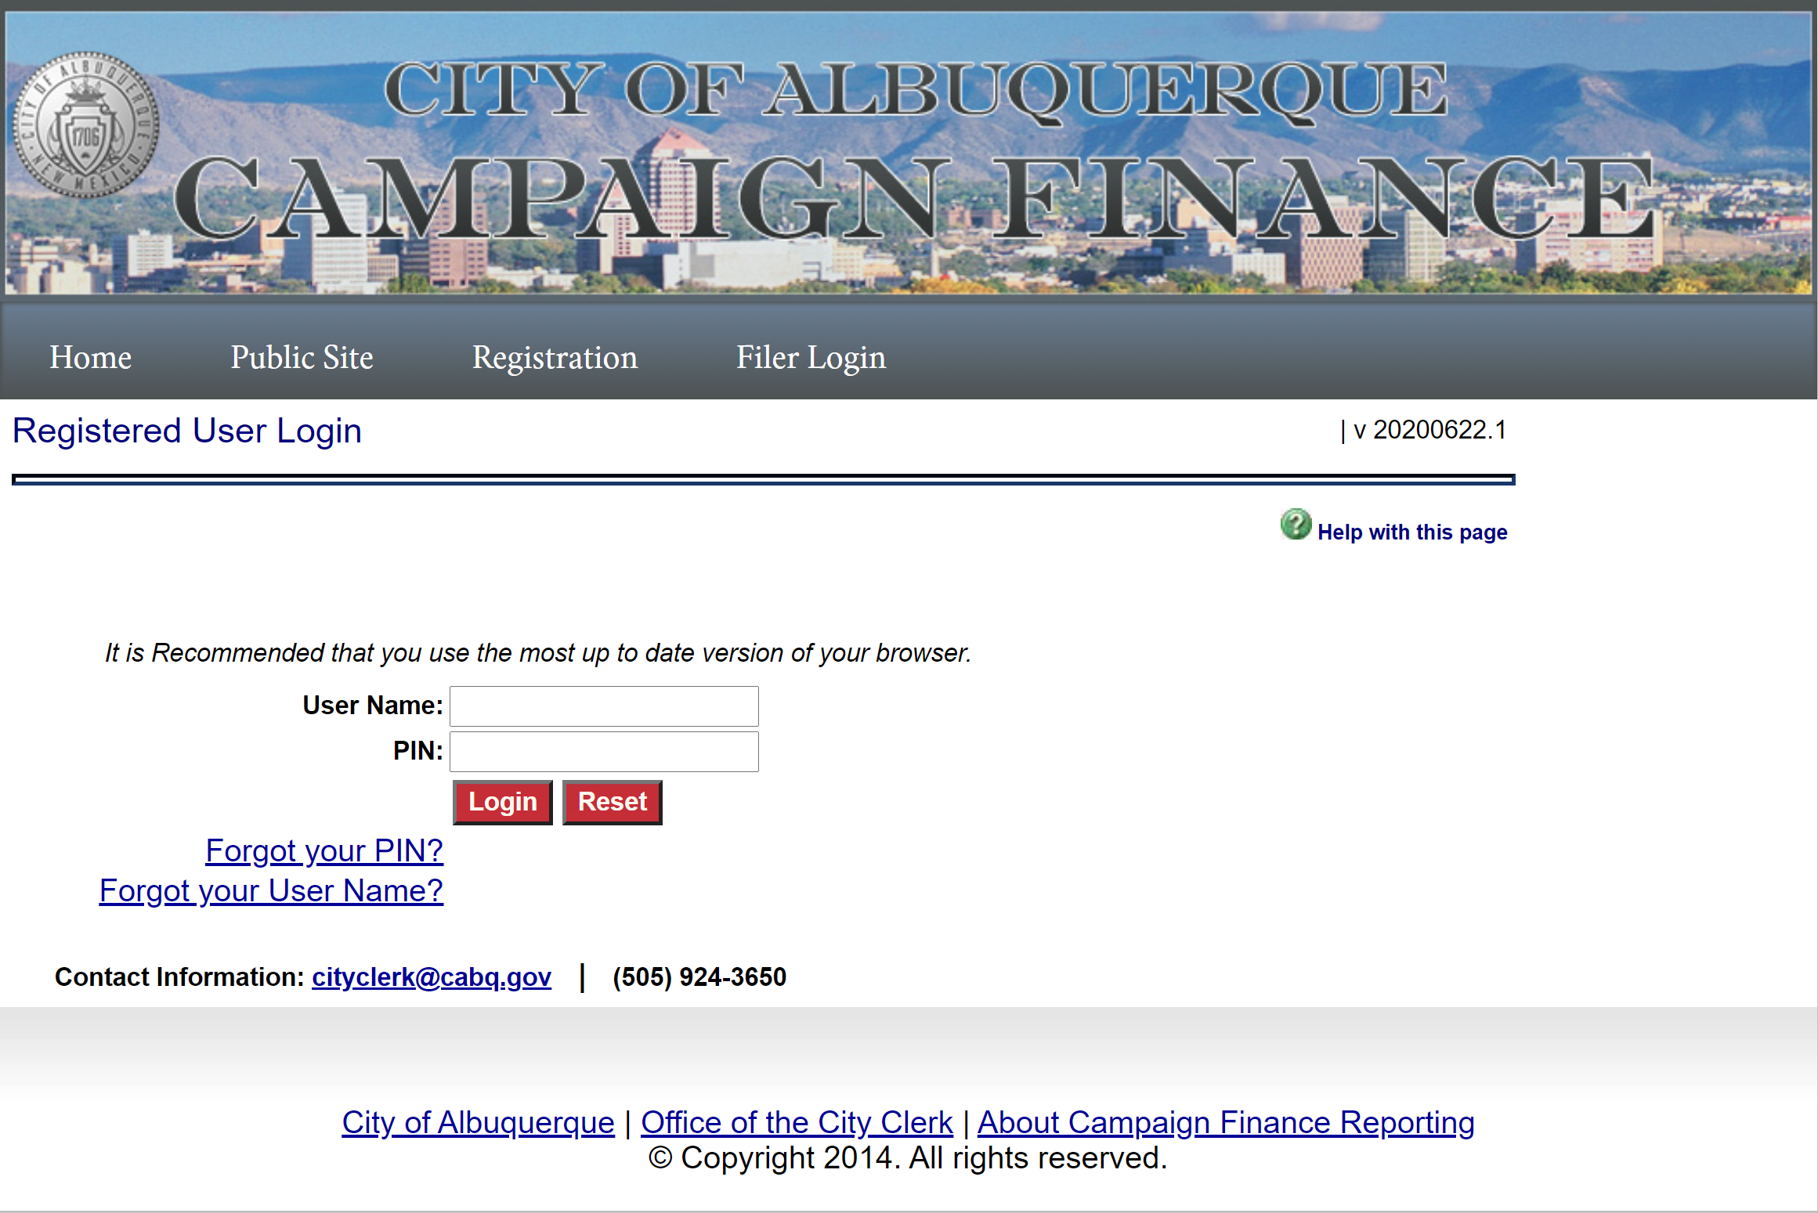
Login
The first time you login, you’ll need to use the User Name and PIN that was sent via email. The system will then ask you to reset your PIN.
Please select something you can remember and write it down. The City Clerk’s Office will be available to reset your PIN, however The City Clerk’s Office will only be available during working hours M-F.

Slide 6
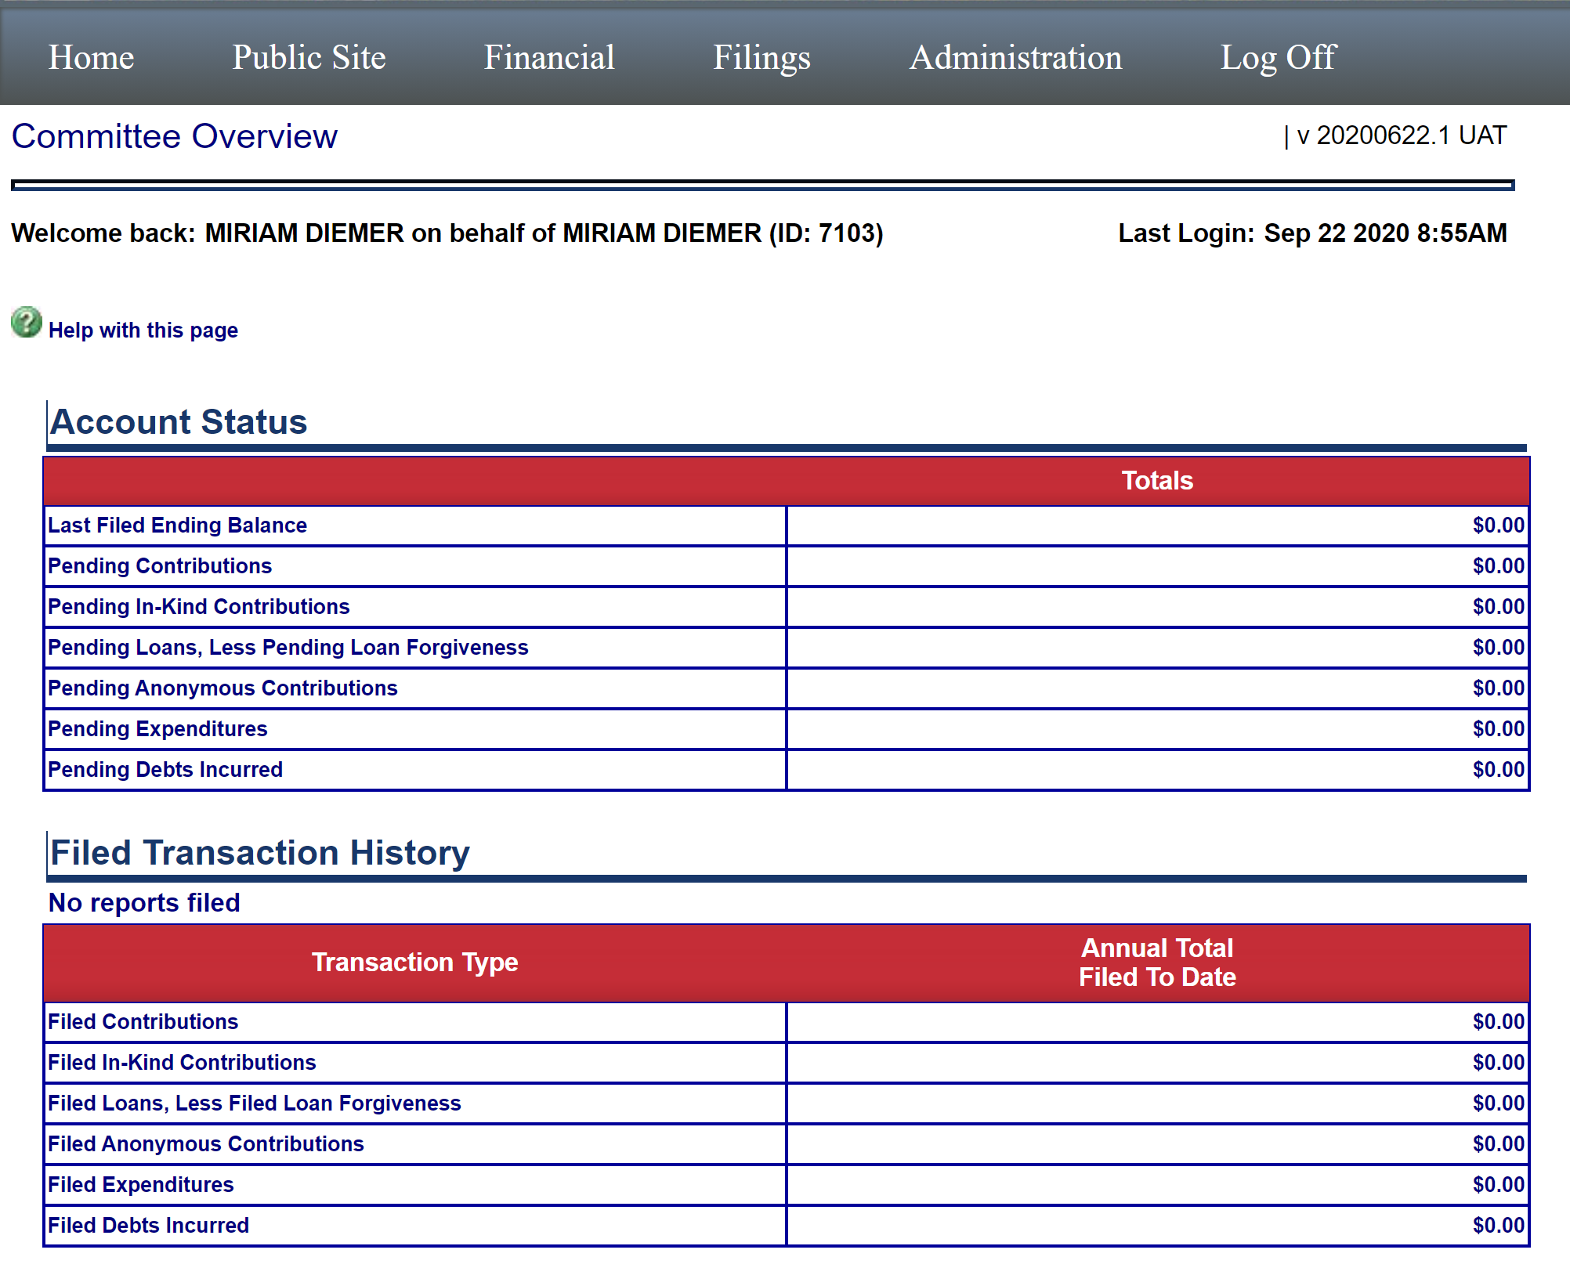
Home
When you first login, your Home screen will show an overview of your account and any reports you’ve filed. If this is your first time logging in, your totals will all show a zero balance. As you begin to add contributions and expenditures and file required reports, these totals will begin to reflect those entries.

Slide 7
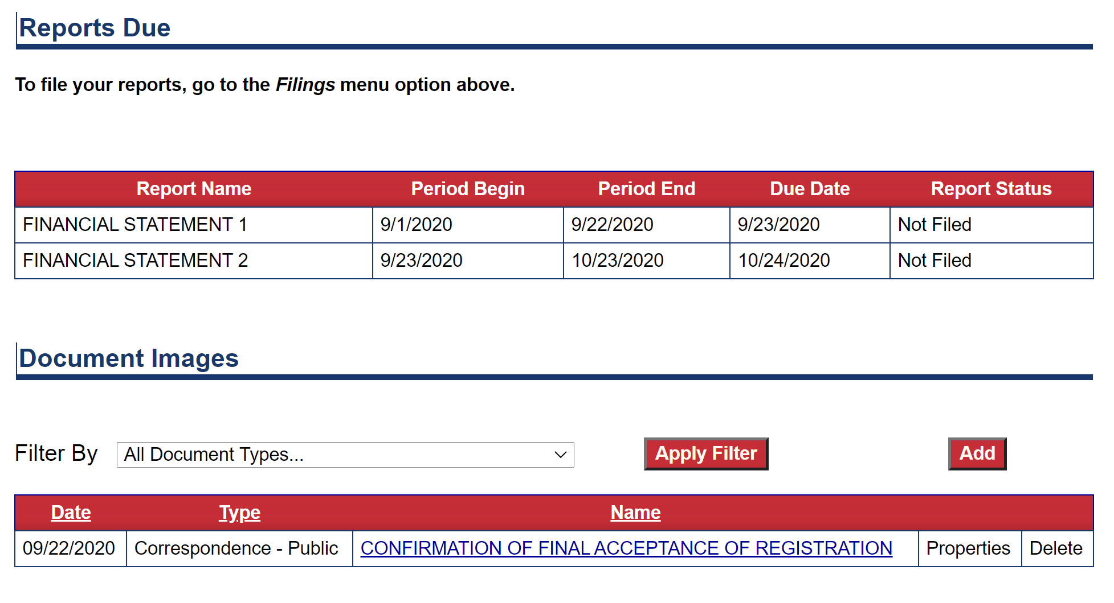
Home
Further down on the Home screen you’ll see a section for report due dates, and documents that you have uploaded.
The Reports Due will show each of the required statements due for your election cycle. It will also update as reports are filed and amended.
Documents are where required forms from the City Clerk’s Office can be uploaded. This will be explained in more detail later in the presentation.

Slide 8
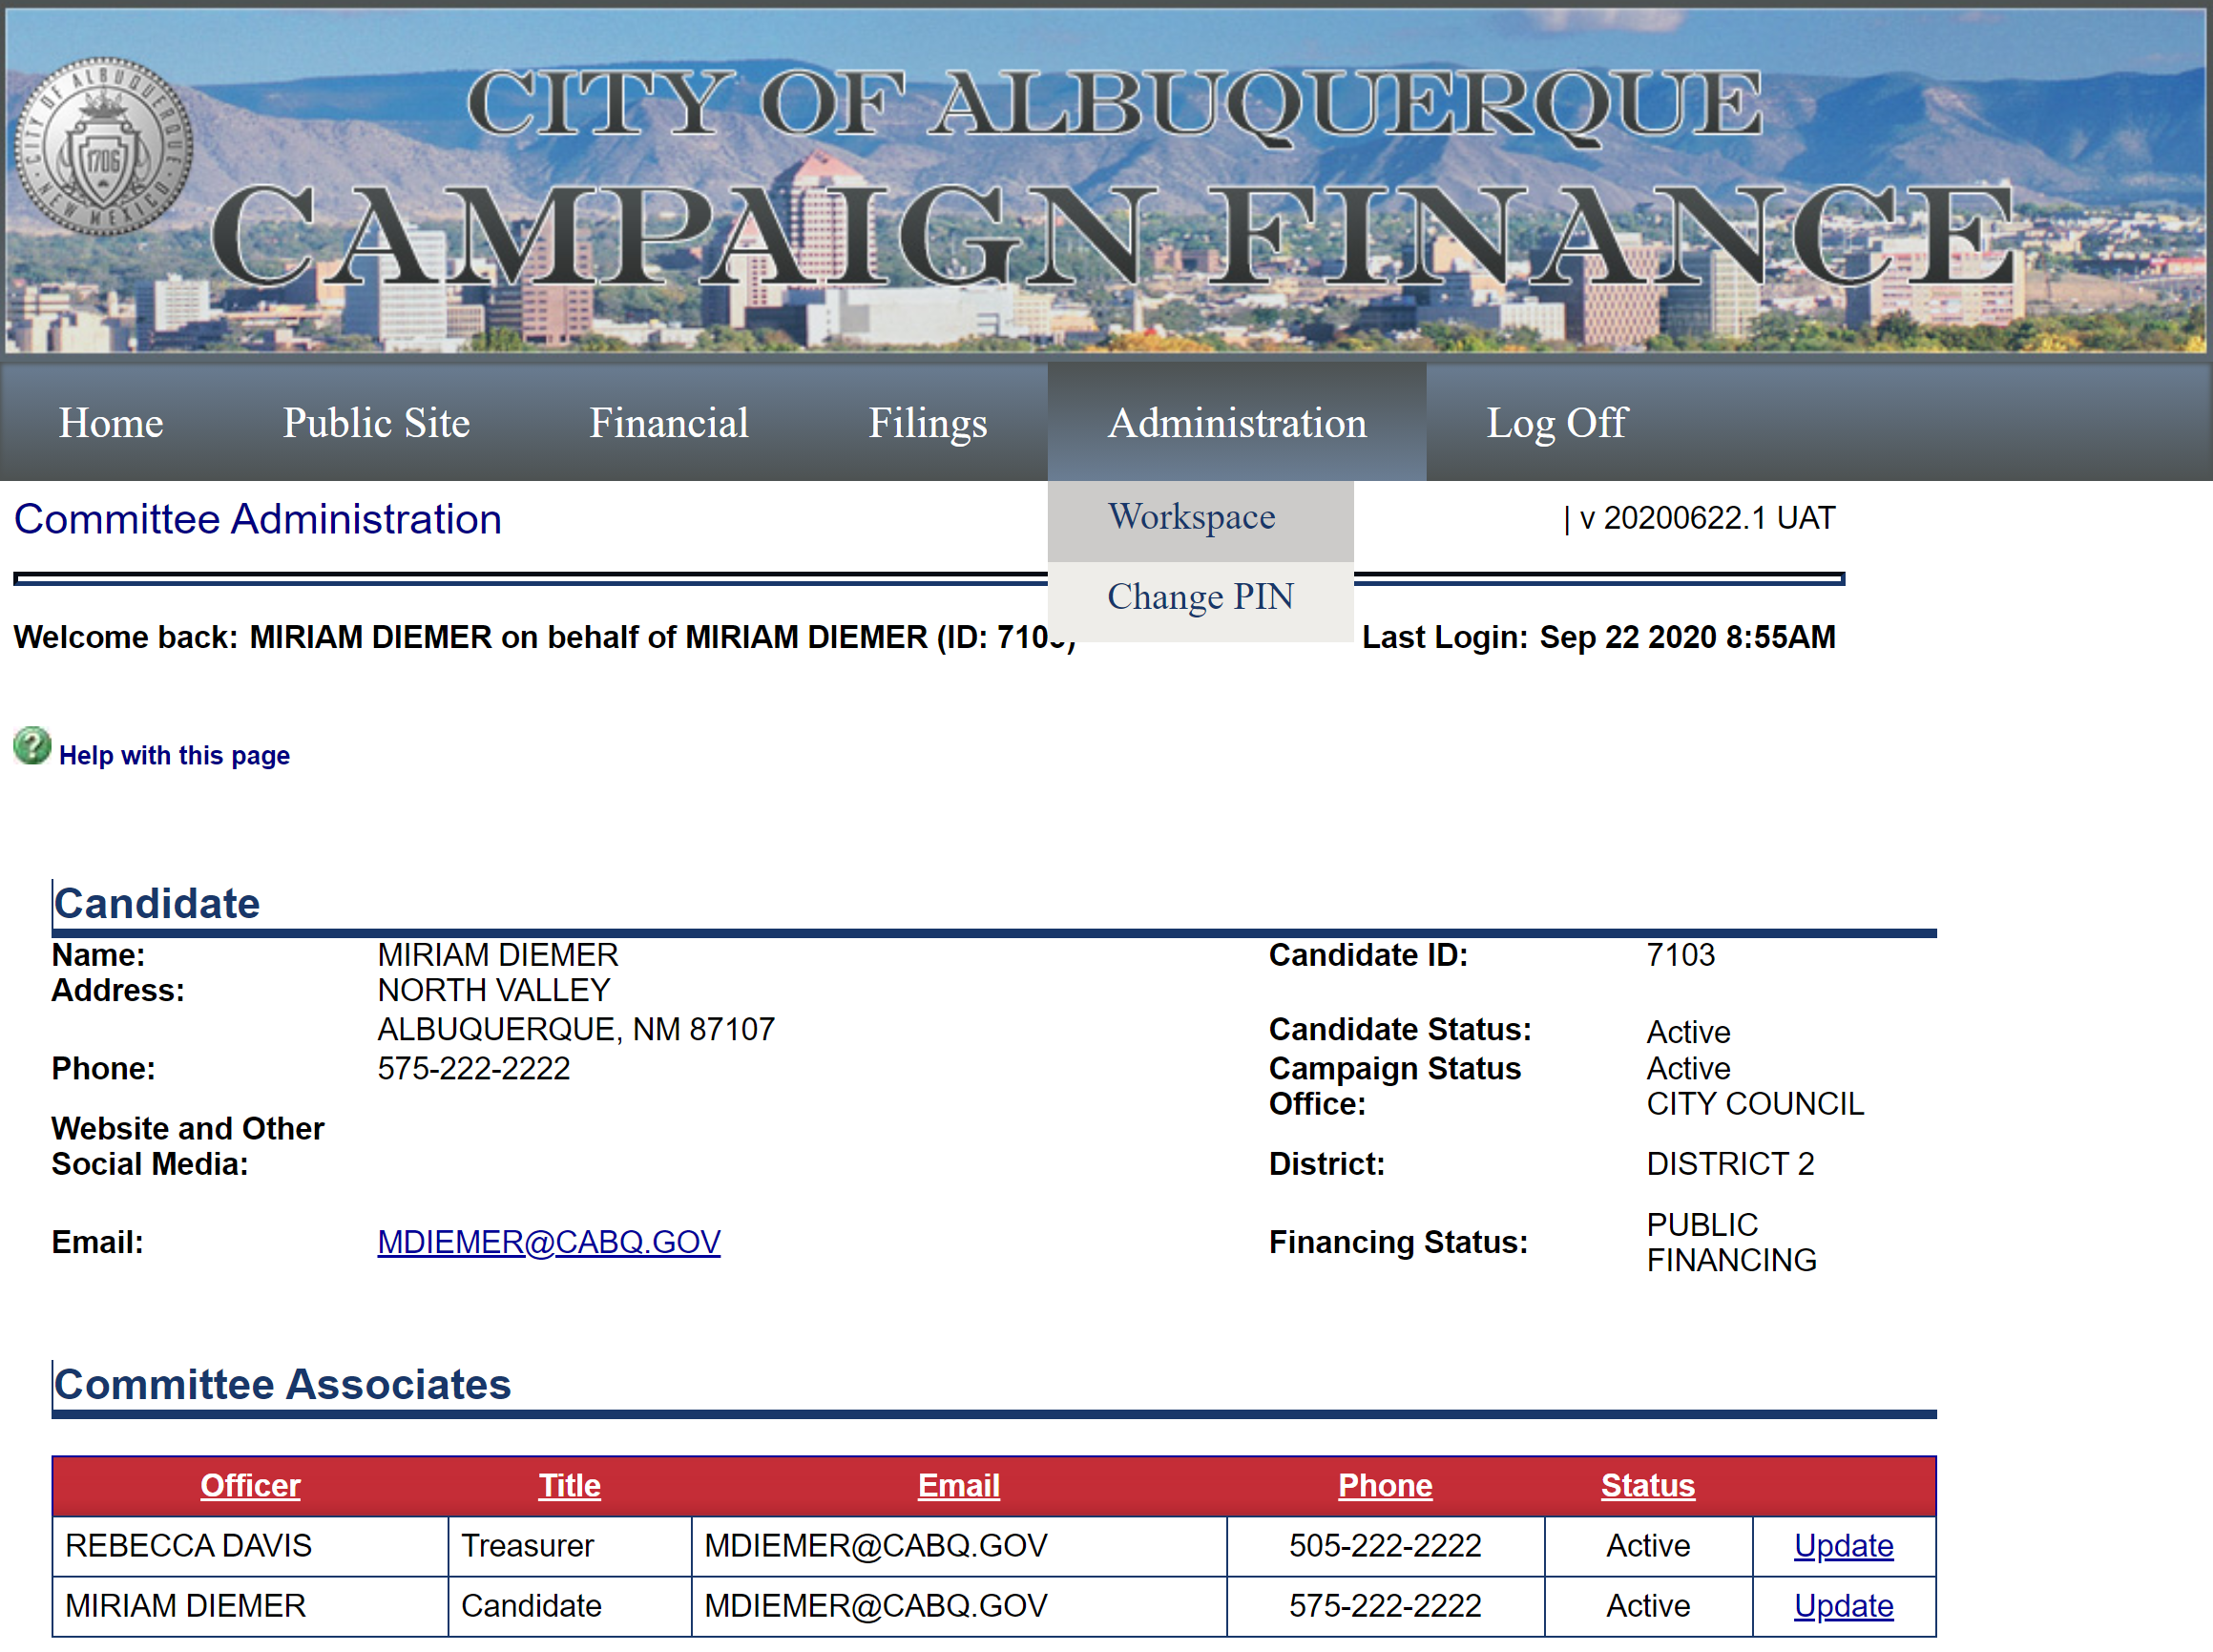
Workspace
From Administration Workspace, you can view the details of the candidate or committee you entered at registration. The Workspace also keeps an Event Log of user activity on your account. Most items on this page require admin privileges to edit.

Slide 9
Financial
The Financial Tab allows the candidate or committee to enter contributions and expenditures as well as any loans or debts.
To get to these pages, hover over the Financial Tab, and then scroll down and click on the item you need to enter.

Slide 10
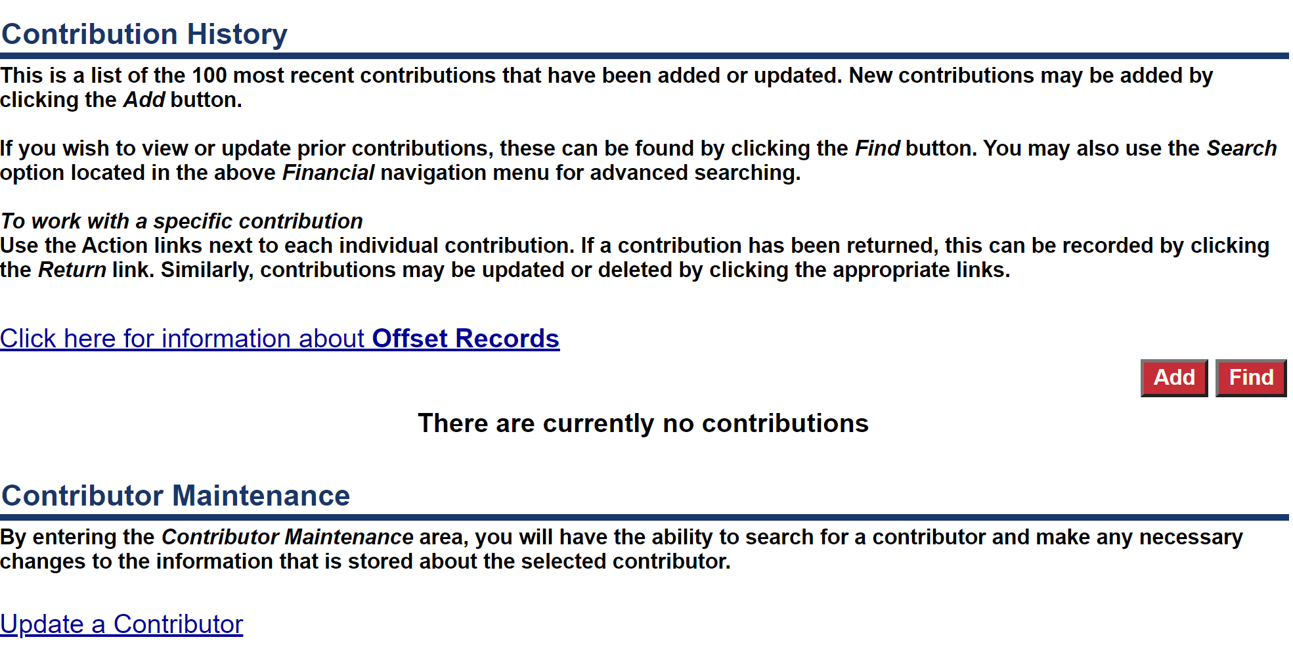
Contributions
The first time you log in, your Contribution History will be empty. This page will begin to populate as you add contributions to your committee.
From this page, you can also make edits to contributors you’ve entered into the system. Once a contributor has been entered into the system, you shouldn’t need to reenter their information each time.
To enter a contribution, just click ADD.

Slide 11
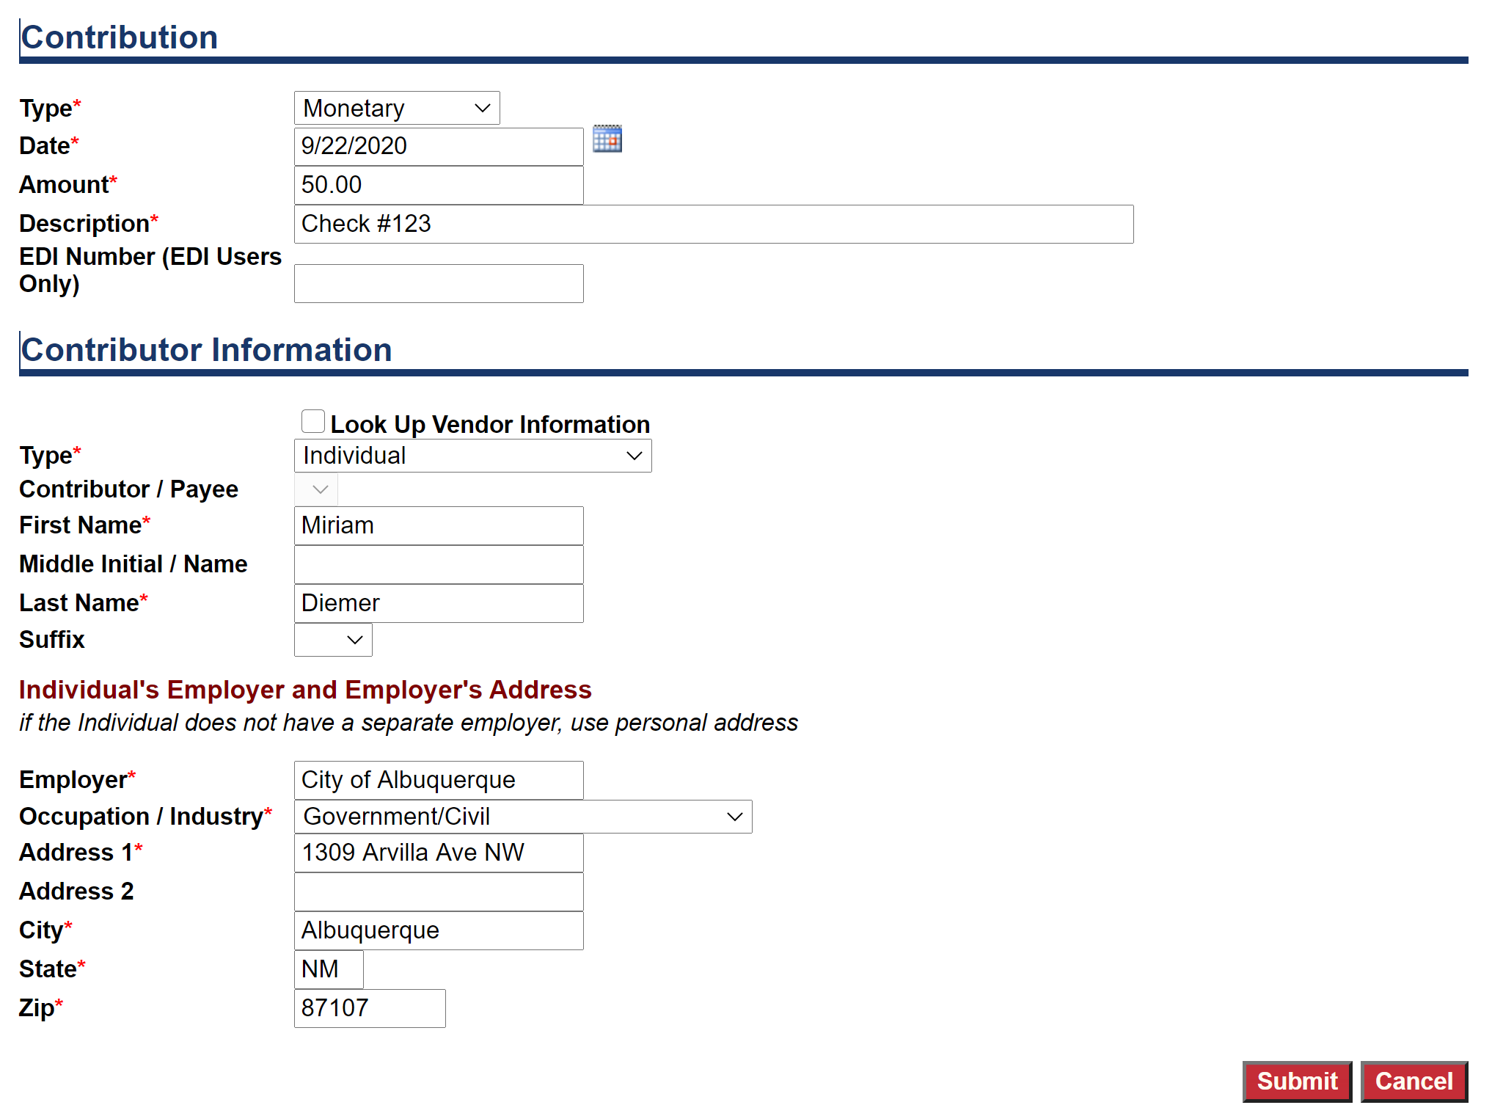
Contributions
A number of items are required to enter a contribution – this is just some general guidance.
Type: Monetary is the most common. Anonymous donations are not allowed, however if you accept one accidently and need to record it in order to dispose of it, you can use that field. Please do keep track of In-Kind Contributions through this page. Public Funding will only be used for the disbursement from the City. The qualifying contributions are not entered into this system.
Description: This field is required and can be used to note cash/check, etc.
Look Up Vendor: If you’re committee has already entered contributors, you can use this field to search for someone’s information.
Employer/Industry: These are required fields.

Slide 12
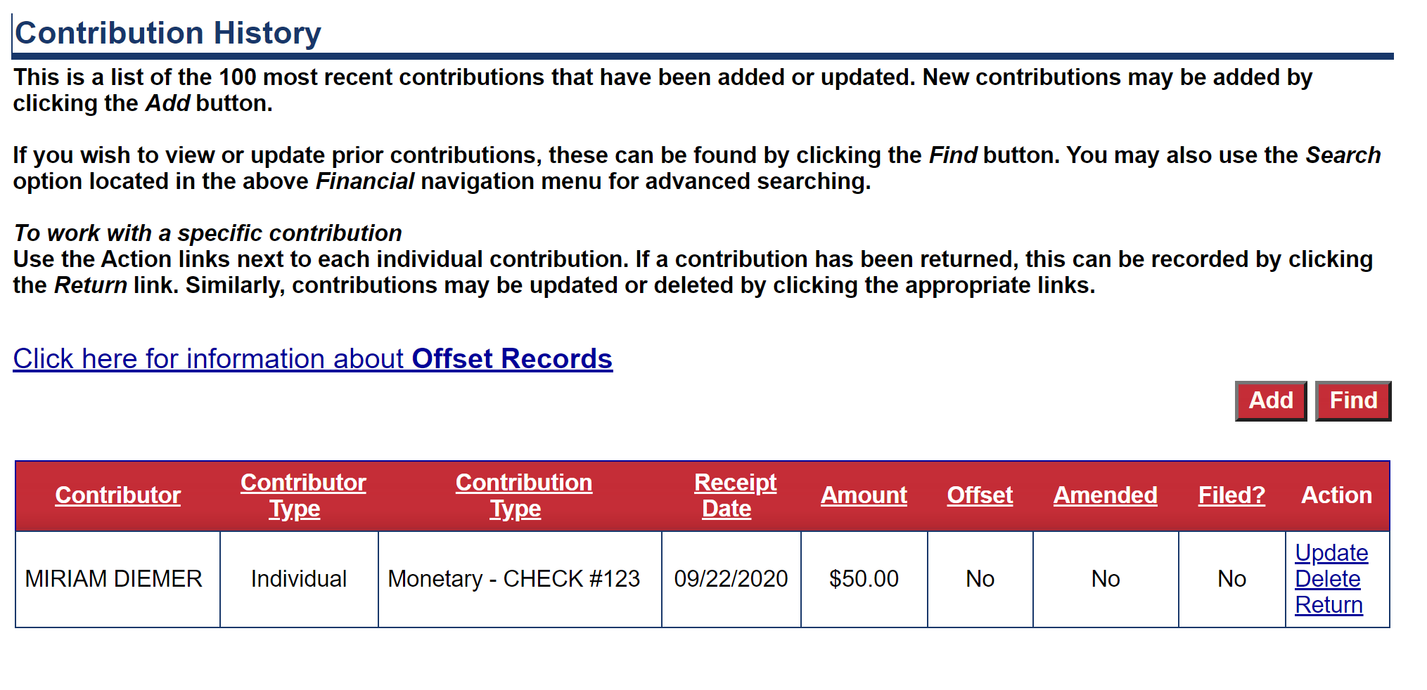
Once you’ve entered a contribution, the table on the Contribution History will begin to populate.
Actions are available to be taken on an entered contribution that won’t be available once that contribution has been filed in a report.
Update will allow you to update information about the contribution, not the contributor. To update information about the contributor, you will have to go to Contributor Maintenance.
Delete will delete the contribution.
Return will initiate a direct return to the contributor.
Contributions

Slide 13
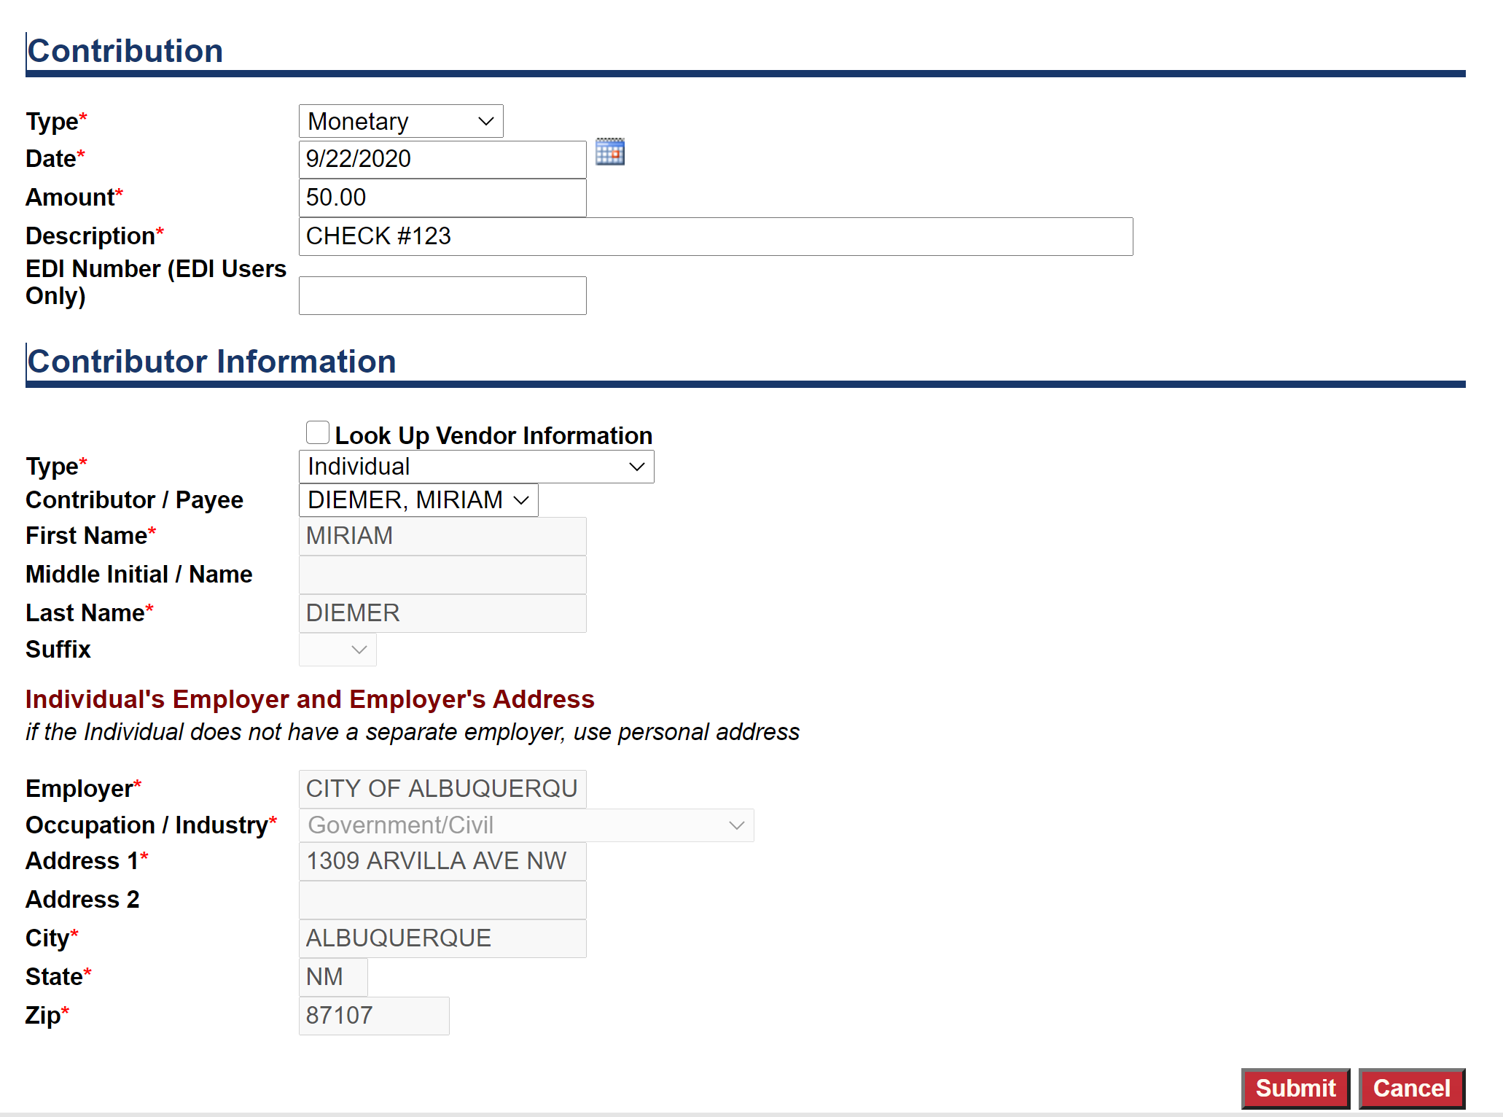
Update Contributions
To update a contribution that has been entered, click on “update” in the action column. This will allow you to update a few items regarding the contribution including the type, date, amount, description, and even the payee.
You cannot update information about the payee from this view. If what you need to update is information about the payee, you will need to do that from Contributor Maintenance from the main Contribution page.

Slide 14
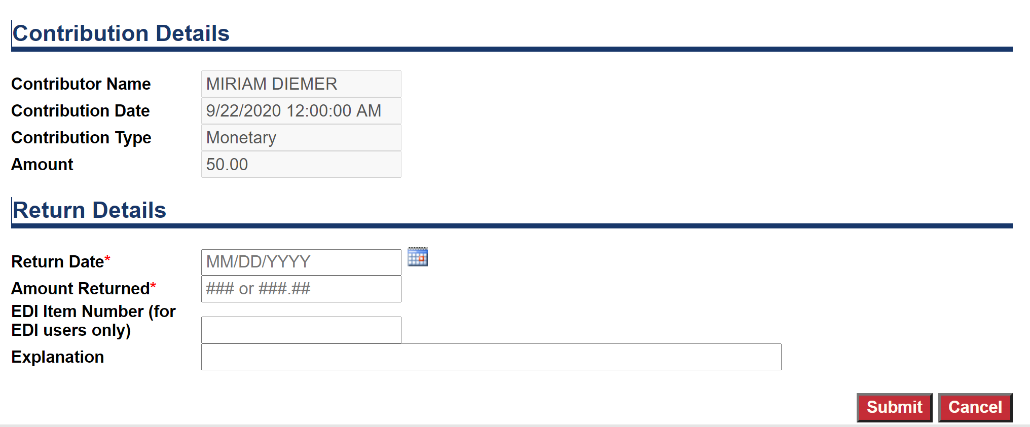
Return Contributions
The Return Contribution action will allow you to create a negative contribution to offset a return to the contributor. An explanation is not a required field however we encourage you to use this for administrative purposes.

Slide 15
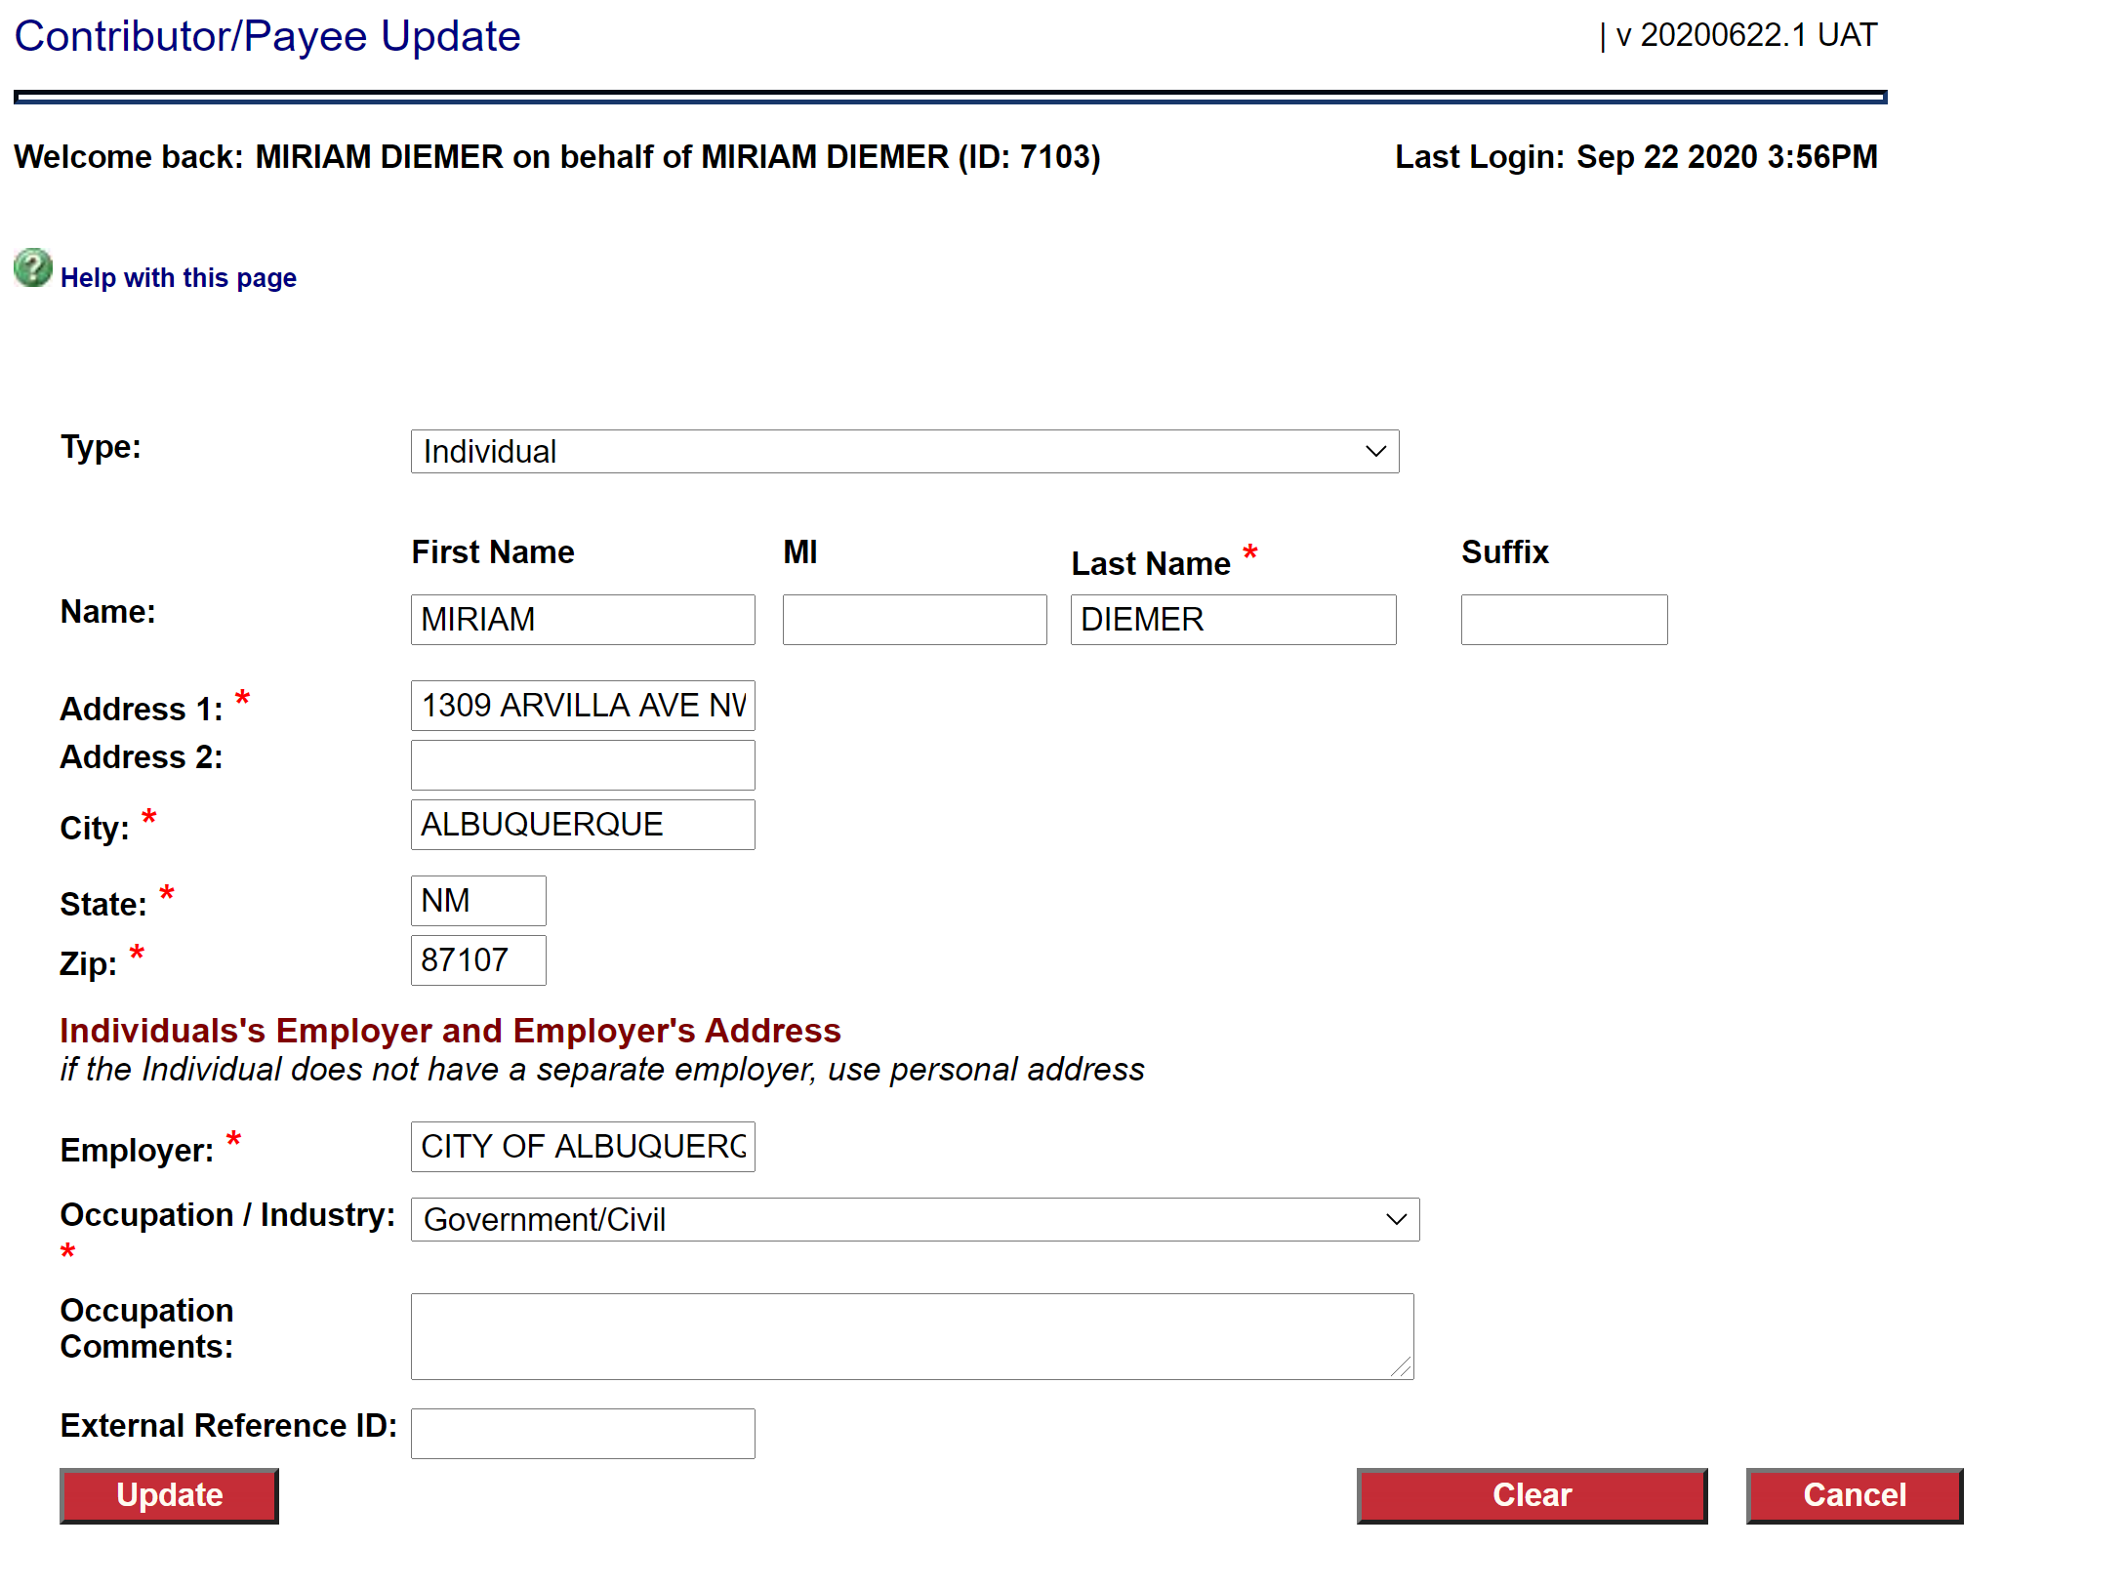
Contributor Maintenance
From the Contributor Maintenance option, you can make edits to the details of a contributor you have already entered.
Edits will update immediately. However, if you are updating a contributor who has made a contribution in a report that has already been filed, that edit will not be reflected in a previously filed report. For that to be reflected, you will need to refile that report once this edit has been completed.

Slide 16
Expenditures
To enter an expenditure, hover over the Financial tab and scroll down and click on Expenditures.
The first time you open this page your Expenditure History will be blank. To begin adding expenditures, just click on the “Add” button.

Slide 17
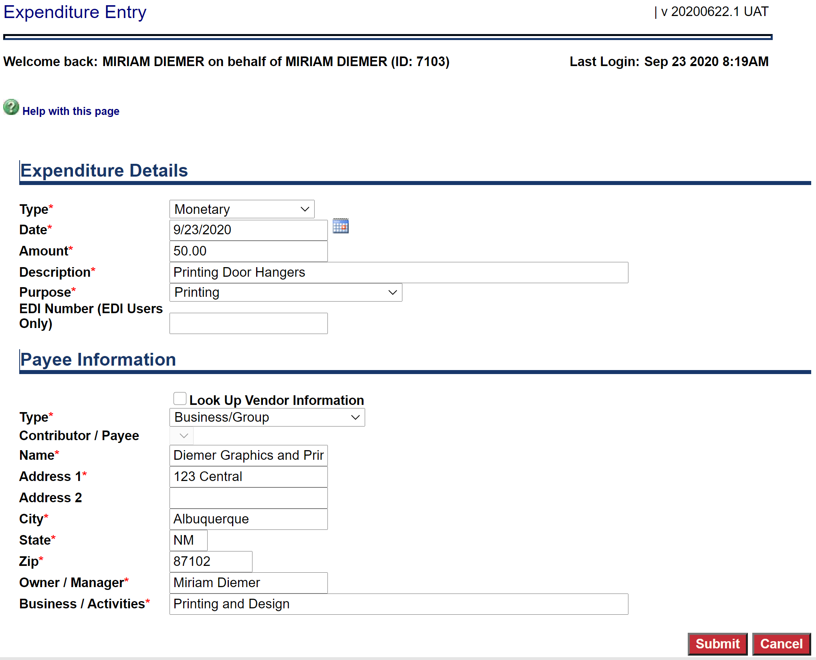
Expenditures
To enter an expenditure, you will have to enter some required information about the specific expense and the payee.
Type: Monetary is the most common type of expense. Disposition of Funds should only be used if you are returning public funds back to the City.
Description/Purpose: These are both required fields. Purpose is a dropdown and may not contain exactly what your looking for, but please select something close.
Type: The type of payee is required and will change the other required information. For Business/Group you do have to enter a Manager and Activities.
Look Up: You can use the Look Up feature if you have previously entered payee information rather than reentering.

Slide 18
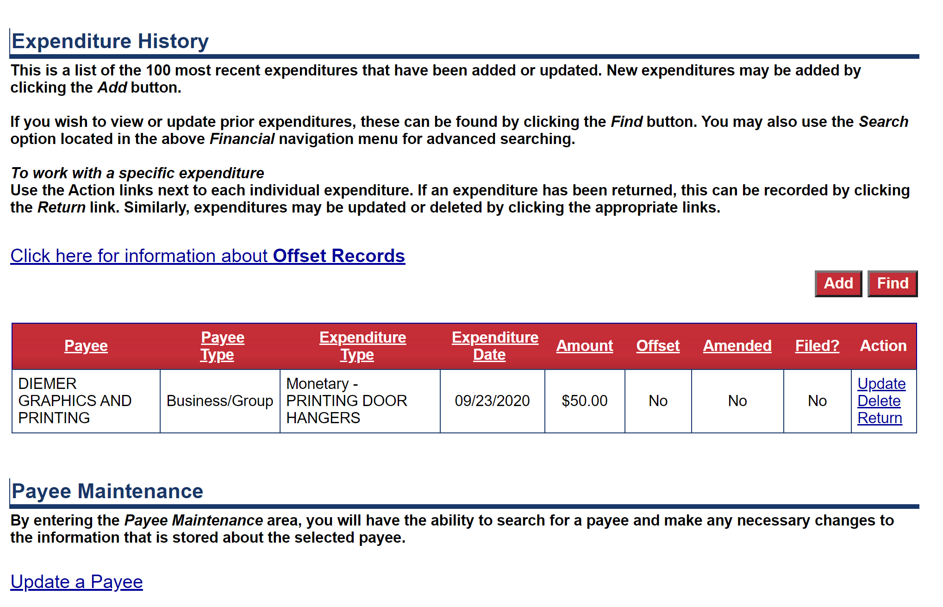
Expenditures
Once expenditures have been entered, they will begin to populate in a table on the main Expenditure page.
This page functions much like the Contributions page. Expenditures can be updated, deleted, or returned by clicking on an Action item.
You can also edit details of a Payee through the Payee Maintenance feature by clicking on Update a Payee.
Just like contributions, once an expenditure has been included in a filing, updates to a payee or an expenditure will require an amendment to the filing.

Slide 19
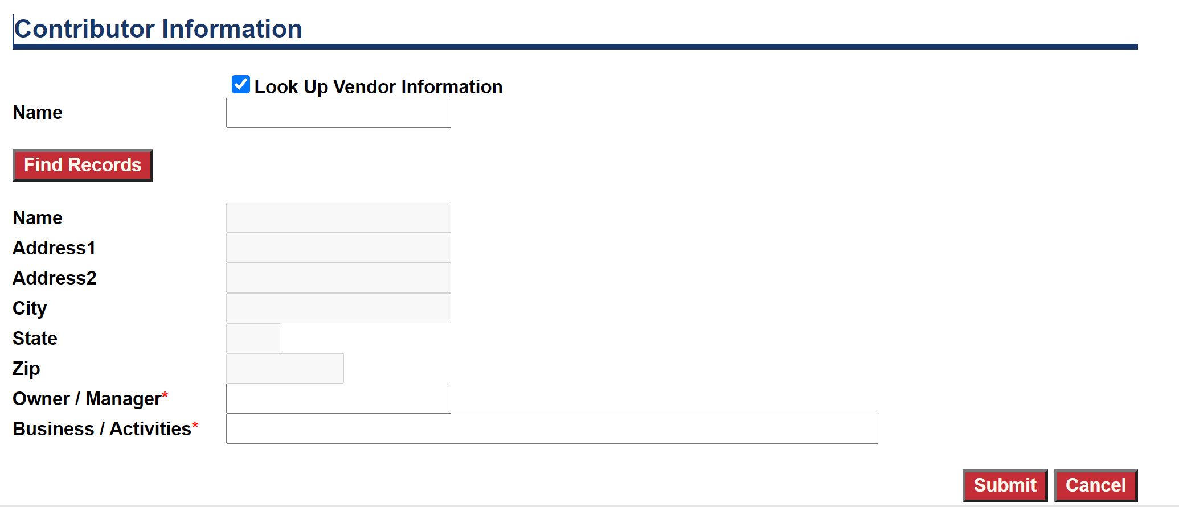
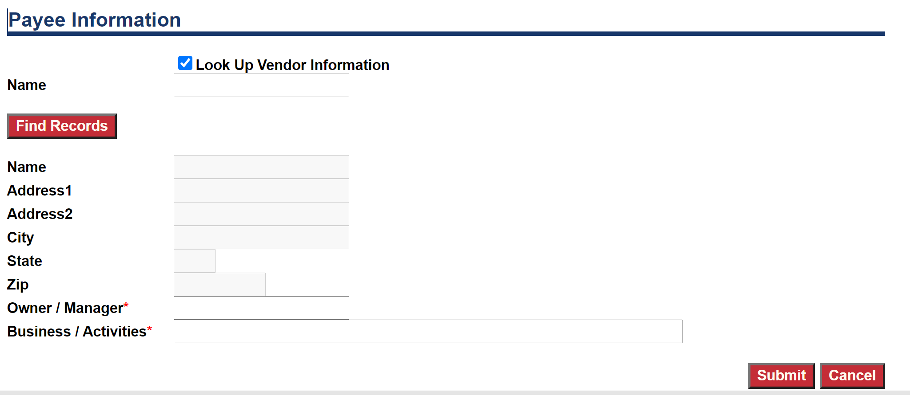
Look Up Features
The Contribution and Expenditure entry pages offer committees the ability to look up contributors or payees that have been previously entered into their system. To do this, you can check “Look Up” and then either type in a name below, or just click “Find Records” which will display an entire list of contributors or payees that you have previously entered. From there, you can select the one you’d like to use and it will auto-populate their information.
For candidates or committees who have previously used this system, an Administrator can upload contributors and payees from past cycles into your current profile. Please just request this when you register or at any point once you start using the system.

Slide 20
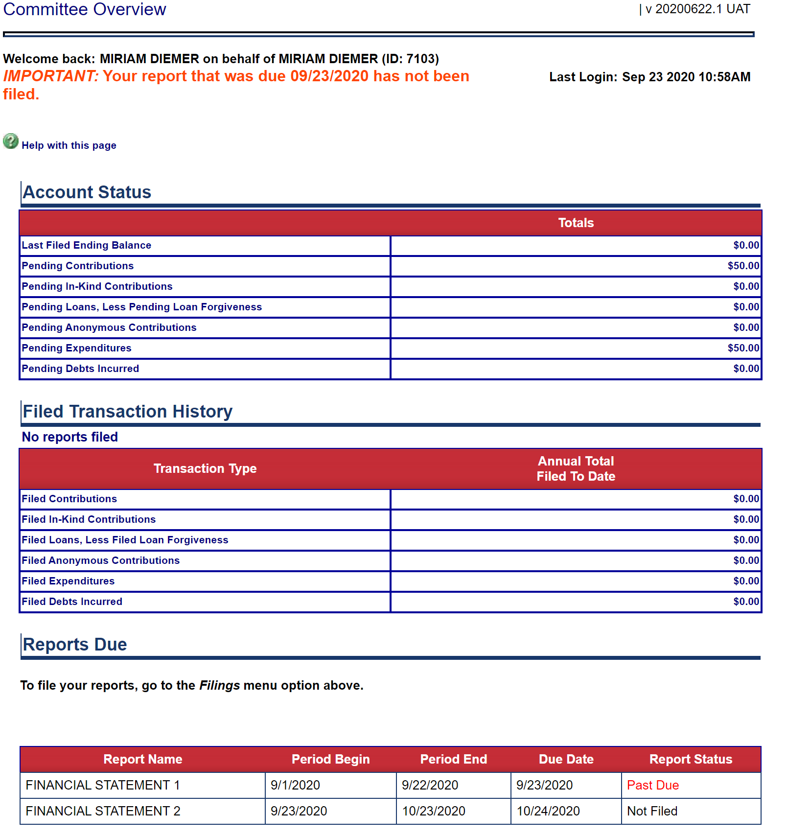
Report Due
When a report is due, the Home screen will have a reminder at the top of the page, and the Reports Due section will update the status to display which report needs to be filed.
To file the required report, you will need to click on the Filing Tab.

Slide 21
Filings
From the Filings main page, you can view the list of statements upcoming, due, and past due, as well as a list of filing already submitted.
To file a report that is due, click on the View/File option under Action.

Slide 22
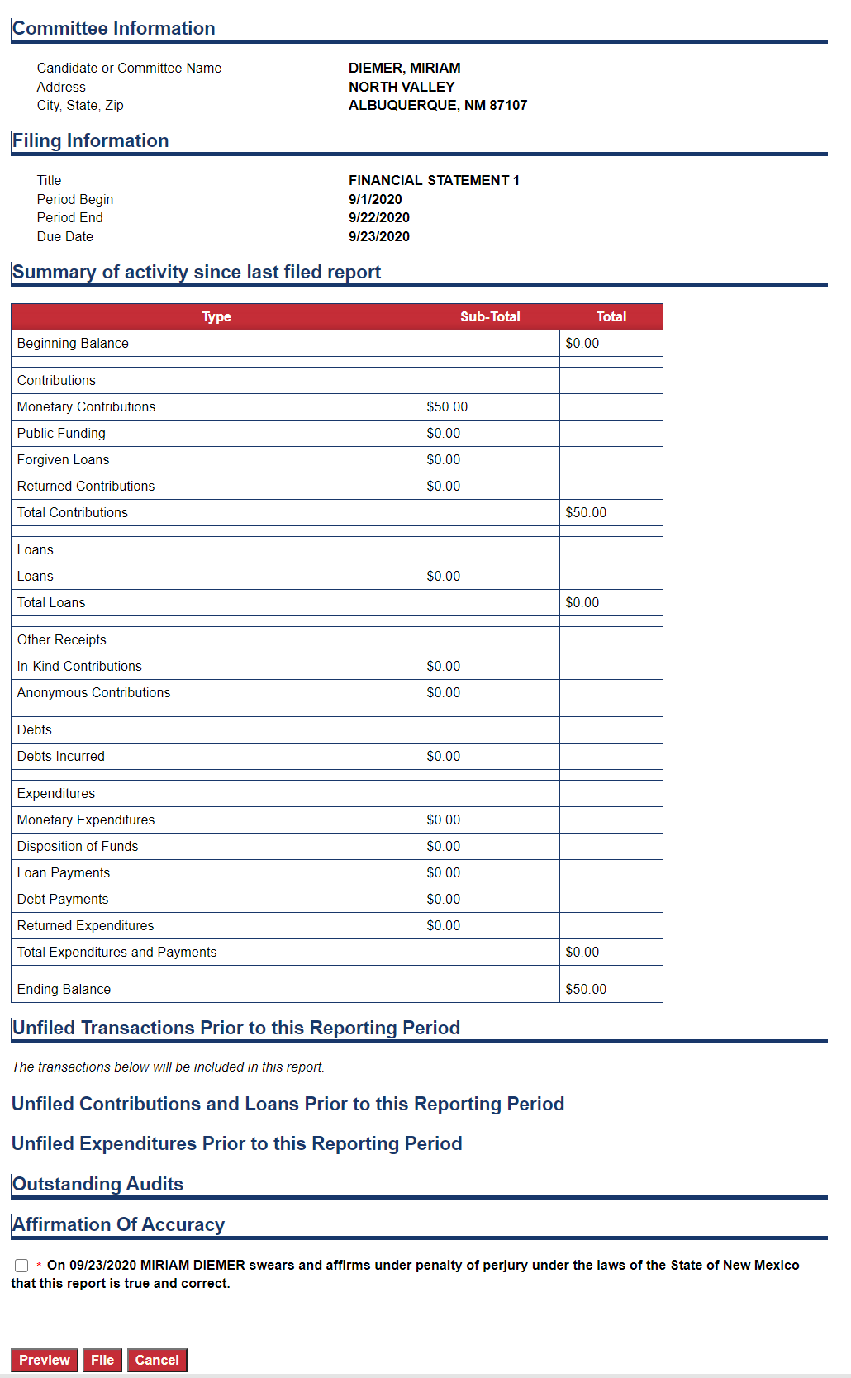
Filings
View/File will populate a screen that displays what your report will look like. From here, you can preview the filing in a PDF, File the report, or cancel the filing if you see something amiss.
Preview will generate a PDF of the report in a pop-up, and you will likely need to allow pop-ups from this website in order to view the report in this format.
Before you can file the report, you will need to click the Affirmation of Accuracy check box that serves as the final signature on the report.
Once you have affirmed the report to be correct, you can click “File.”

Slide 23
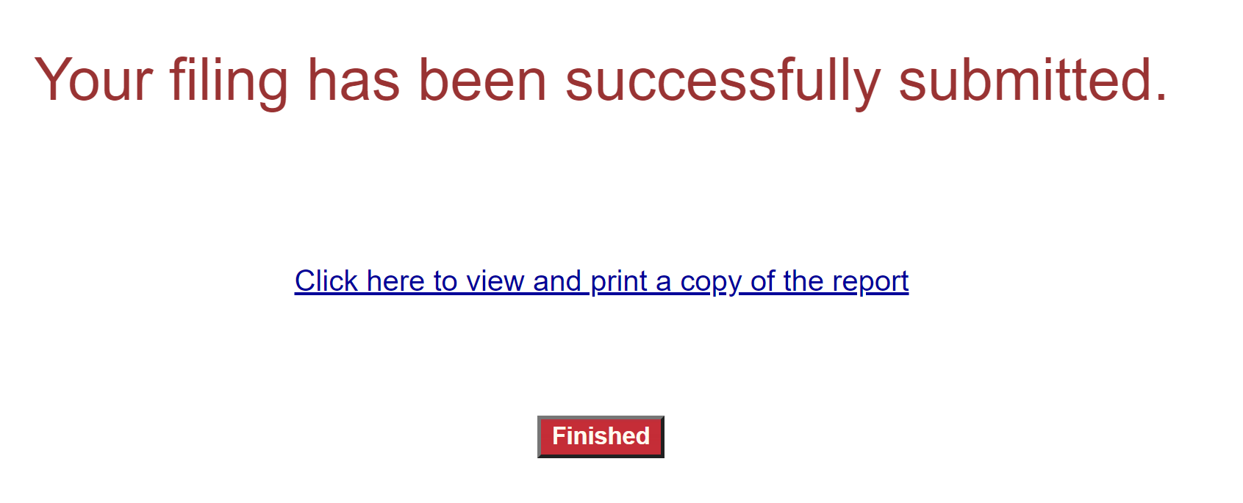
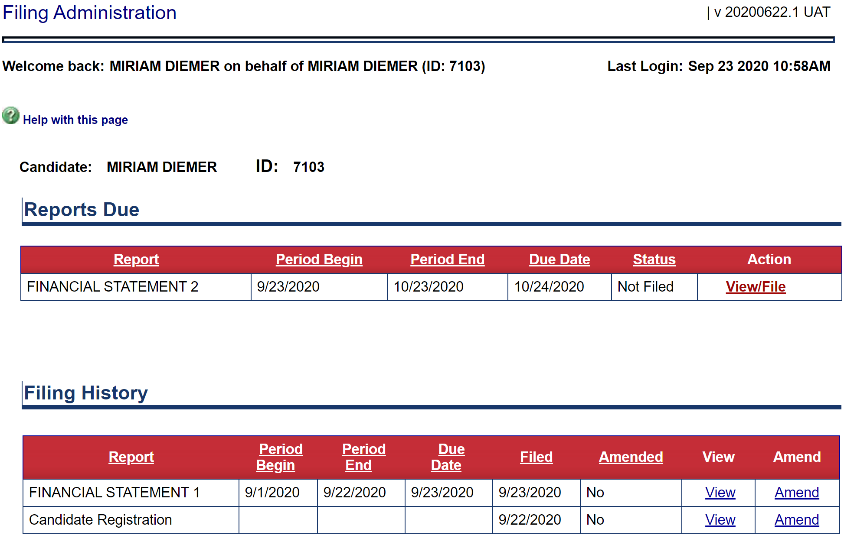
Filings
Once you have clicked “File” you will receive the notice that your filing has been submitted. From this screen, you can view the report in a PDF format, or click “Finished” to return to the main Filings page.
The main Filings page will display your upcoming reports due, and a list of your filing history. The report you just submitted will be displayed in the Filing History. From Filing History, you will be able to view the report, or amend the report.

Slide 24
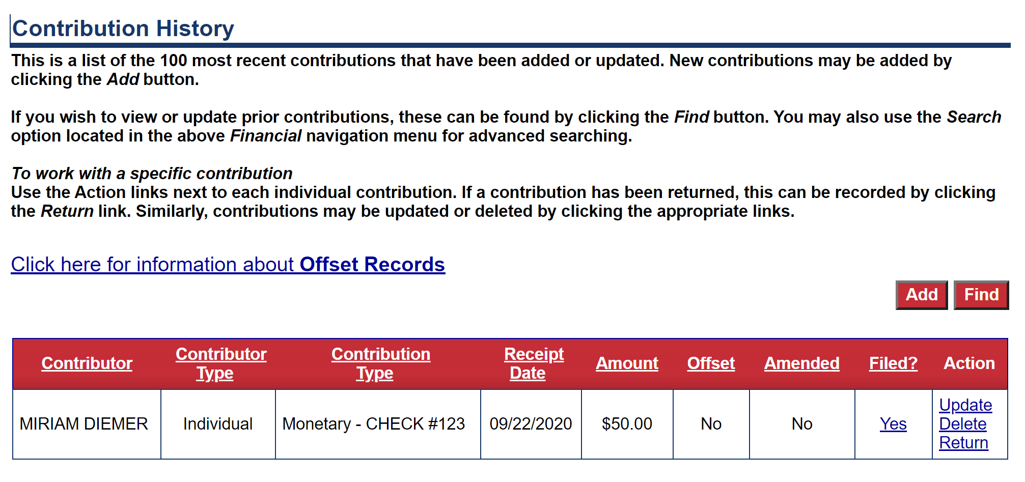
Amend Filing
To amend a filing that has already been submitted, you will have to fix the contribution or expenditures that needs correction in the contribution or expenditure pages.
For example, this contribution has been filed, but if I entered the wrong amount and filed this report, I’d need to come into the Contribution page, and click Update to fix this contribution before I can amend the report I submitted.

Slide 25
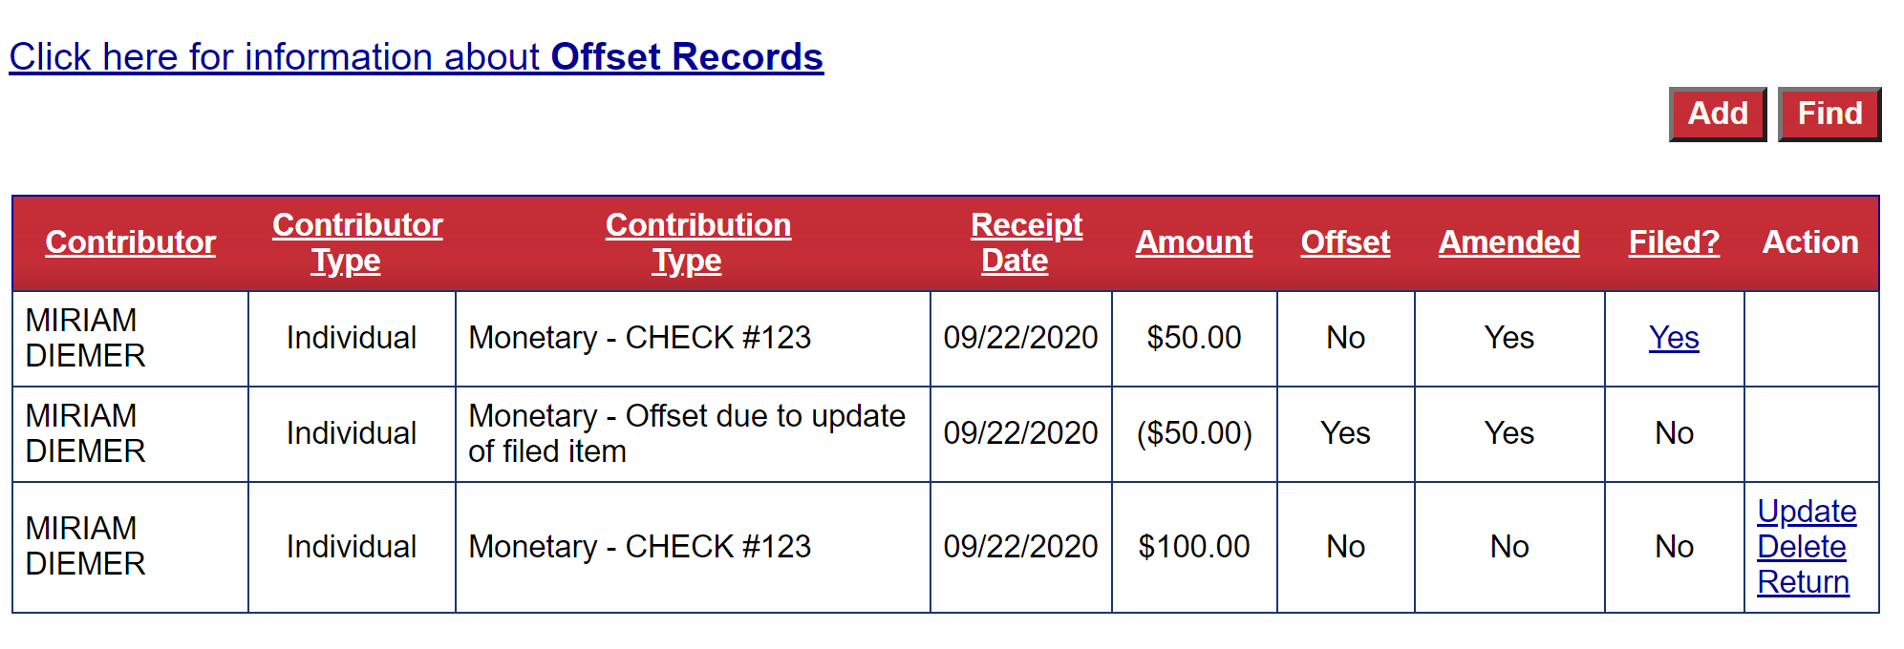
Amend Filing
Once you update the contribution or expenditure that needed correction, the update will display on the main Contribution or Expenditure page. The update will show as an offset, and a new entry.
Because at this point I haven’t yet filed the amendment, only the original contribution is showing as having been filed.
Now that I’ve made the correction, I can return to the Filing page.

Slide 26
Amend Filing
From the main Filing page, I can now find the report I need to amend, and click on Amend.

Slide 27
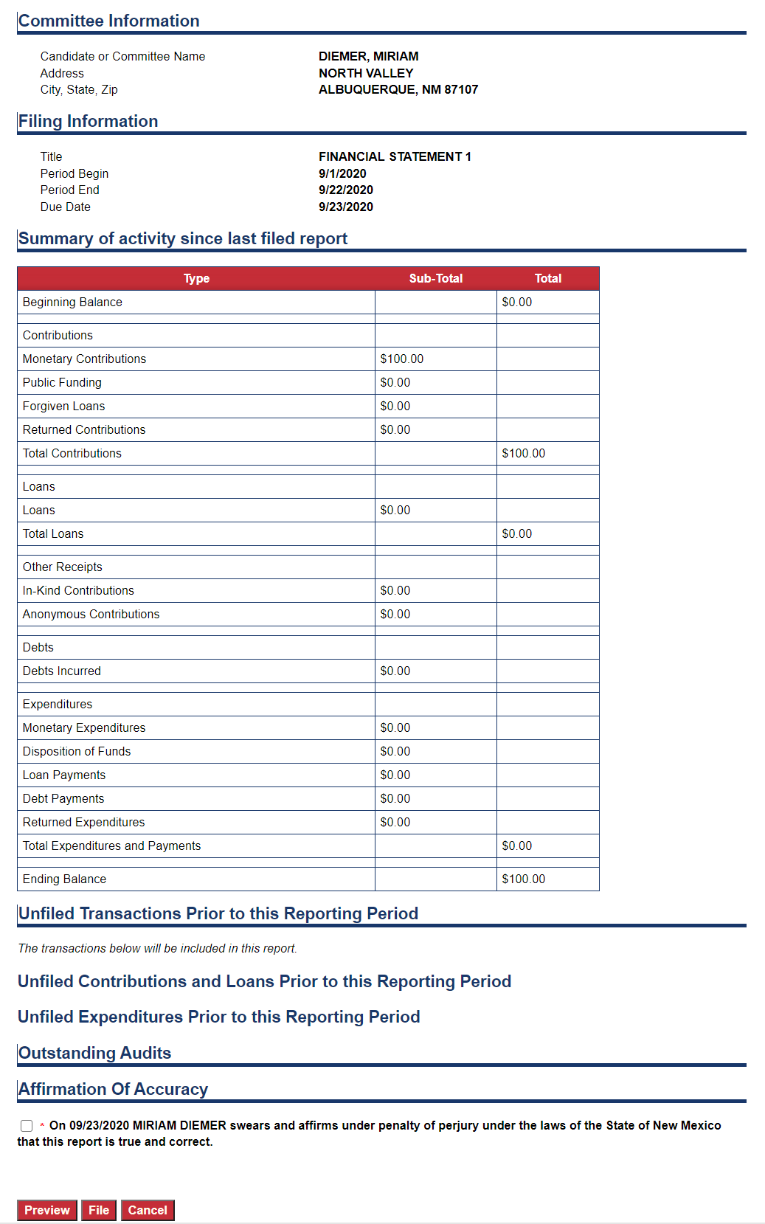
Amend Filing
The Amended report should display the edits I previously made in contributions or expenditures. It won’t display them as offsets as they do in the tables, but rather, it will display the new totals as amended.
If the amended report looks correct you can again either preview a PDF of the report, or check the Affirmation of Accuracy, and then click “File” to submit the amended report.

Slide 28
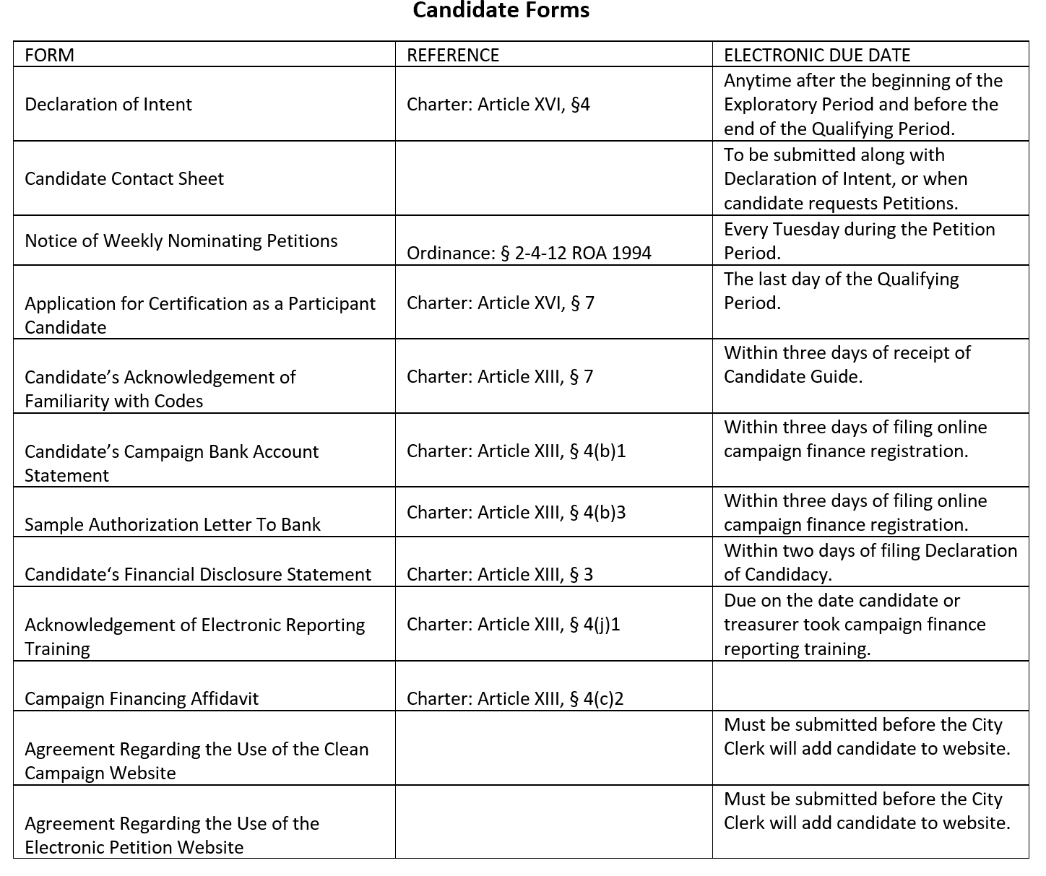
Upload Required Documents
The City Clerk’s Office requires a number of forms to be submitted by Candidates and Committees over the course of the election cycle. To view what these forms are and the dates they are required to be submitted, please refer to the Candidate Guide or the MFC Guide posted on the City Clerk’s website.

Slide 29
Upload Required Documents
To access the fillable PDF forms, click on the Public Site tab on the top of your screen.
Then hover over Resources and click on Forms.

Slide 30
Upload Required Documents
From the Downloadable Forms section you can click on and download the required form you need to upload. This link will take you to a fillable PDF form.
You will need to save the form on your local drive, fill it out electronically, and then safe the changes you made to the form.
You can also print these forms and fill them out by hand. You will then need to scan and save them so they can be uploaded back into the system.
Please do not email the electronic forms to the Clerk’s office. The following slides will show you how to upload them back into the Campaign Finance site.

Slide 31
Upload Required Documents
From the Candidate or Committee Home screen, scroll down to the bottom of the page to the Document Images section.
From there, just click “Add.”

Slide 32
Upload Required Documents
Once you’ve clicked “Add” the system will direct you to an upload feature.
From here, you can search the drop-down for the Document Type you need to upload back into the system.

Slide 33
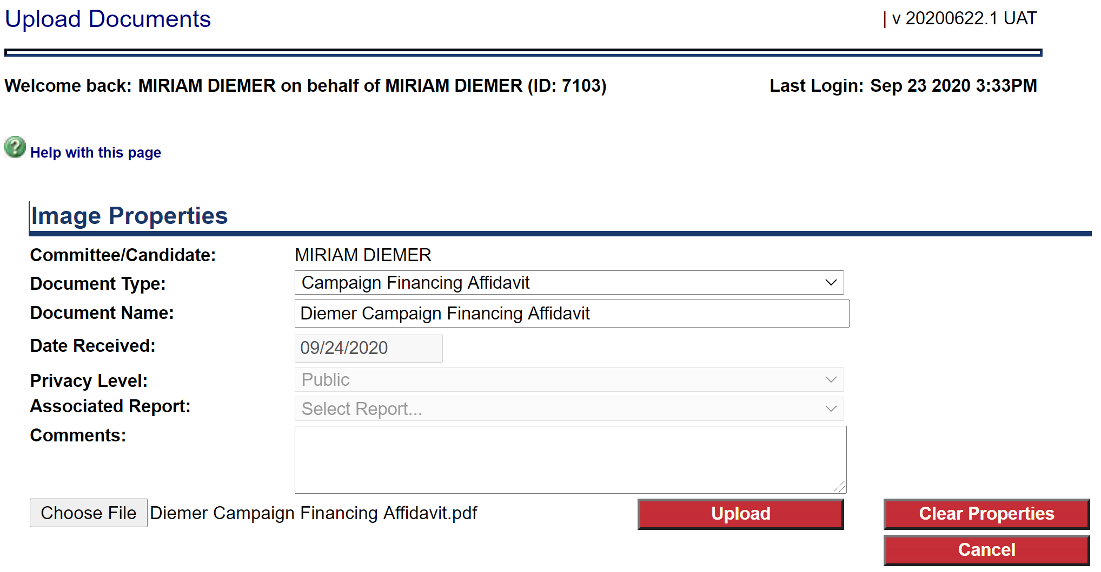
Upload Required Documents
Once you select the Document Type, you’ll need to type in a Document Name. Please select a name that reflects the Candidate or Committee as well as the document type.
Date Received and Privacy are auto-populated based on the type of document.
You can then click on “Choose File” to upload the document from your computer.
Click “Upload” when everything looks correct.

Slide 34
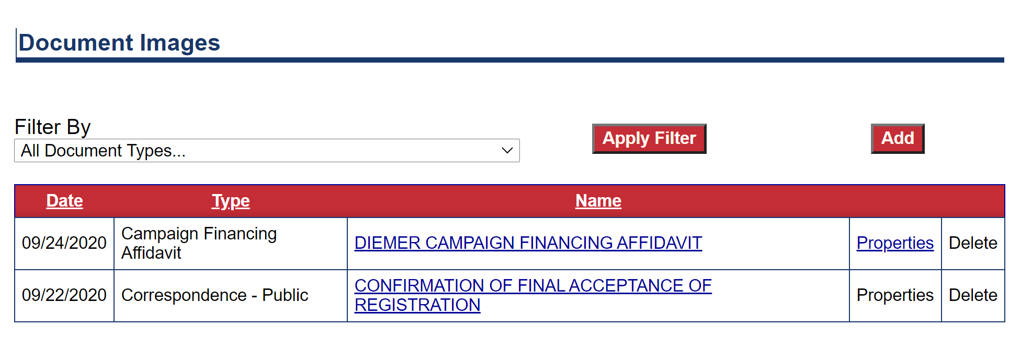
Upload Required Documents
From the Home screen, you will now be able to view the uploaded documents. By clicking on the Name of the document, you will be able to view the PDF of the uploaded document as well.

Slide 35
Questions
If you need any further assistance with the reporting system, please contact the City Clerk’s Office at:
505-924-3650
or email
elections@cabq.gov

