Slide 1
Senior Affairs Point of Sale System Memberships Training Course
Section 8
Aggregate Cards and Special Reporting Codes in DSA Point of Sale System (For meal sites only)
Revised December 28, 2016

Slide 2
DSA Point of Sale Memberships Course-Section 8 Aggregate Cards/Special Reporting Codes in DSA Point of Sale System (For meal sites only)
Aggregate Cards at front desk: 3 Specific age eligibility Aggregate Cards will be kept at the front desk of each center facility. (White 18-49, Yellow 50-59, Blue 60+)
Use the Aggregate Cards with the Specials Codes to track exceptions for meals in Siriusware
Aggregate Card: Aggregate Cards should be used only for exceptions (e.g. one-time guest) and in certain special AAA meal eligibility qualifying exceptions along with the appropriate “special” code in the Siriusware system.
Aggregate Cards for Meal Reconciliation: In order for financial reporting to be accurate, Aggregate Cards shall only be used when there is a one-time guest, or the person falls into the alternate meal eligibility and does not have a membership card and has not yet filled out a SAMS form (only one time allowance).

Slide 3
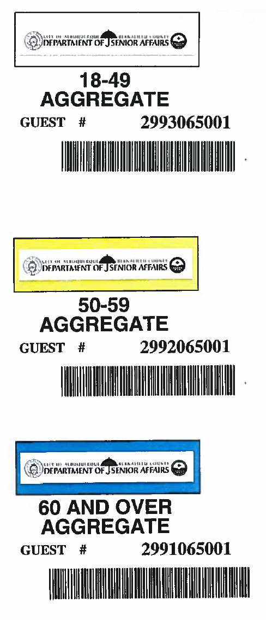
DSA Point of Sale Memberships Course-Section 8 Aggregate Cards/Special Reporting Codes in DSA Point of Sale System (For Meal Sites Only)

Slide 4
DSA Point of Sale Memberships Course-Section 8 Aggregate Cards/Special Reporting Codes in DSA Point of Sale System (For meal sites only)
Scenario-Volunteer in a Meal Site Kitchen:
A volunteer in a meal site kitchen may receive meal for the day that they are volunteering and the tasks must be associated with preparation or cleanup of the meal. In this instance, the Aggregate Card should be used to track the eligible meal transaction.
Note: If a DSA site has a volunteer that is always on site, a membership card may be issued with the correct age eligibility class. The Front desk should have a list of the volunteers and check the list for the volunteer name when a person is getting a lunch meal.
Example: Don Gomez is only volunteering today at Barelas Senior Center in the kitchen. He goes to the front desk to put his order in for lunch. Don has NOT filled out a SAMS form and is not in the SAMS system. Don is eligible under the AAA guidelines for a free meal for his time in the kitchen volunteering for that day. He will have had to make a reservation the day before or wait for all meals with reservations to be served first.
You will use the appropriate age color eligibility Aggregate Card to the transaction in Siriusware for Don’s meal. You will NOT run the Aggregate Card through the SAMS system for the one-time guest meal, only through Siriusware because he has NOT filled out a SAMS form and is not in the SAMS system and this meal is not reimbursable to DSA; DSA will cover the cost of this meal.
Again, only meals that are for people who have filled out and are entered into the SAMS system are reimbursable by AAA and tracked in the SAMS system.

Slide 5
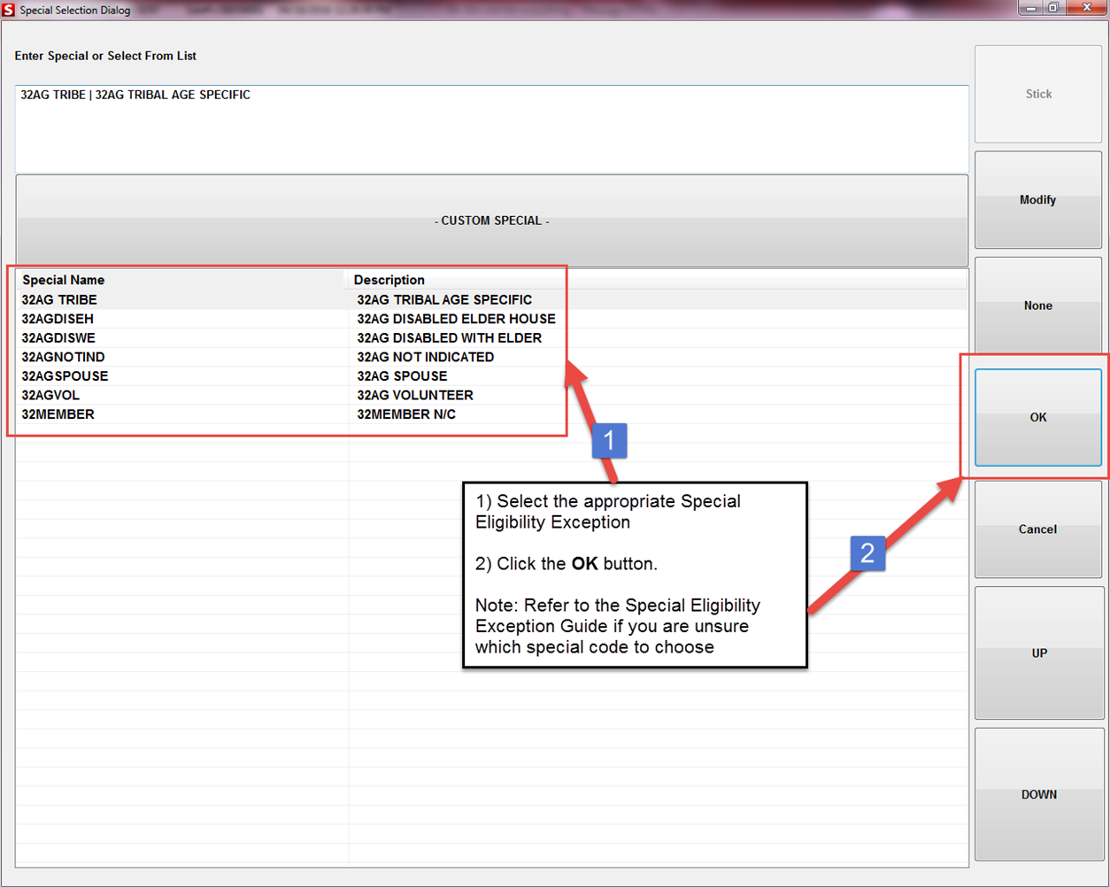
A
Select the appropriate Special Eligibility Exception.
Click the “OK” button
Note: Refer to the Special Eligibility Exception Guide if you are unsure which special code to choose.
B

Slide 6
DSA Point of Sale Memberships Course-Section 8 Aggregate Cards/Special Reporting Codes in DSA Point of Sale System (For meal sites only)
Do NOT use the aggregate card for lost or forgotten cards. Please refer to the Lost or Forgotten Card section of this manual.
Aggregate Cards Siriusware/SAMS: Only run an aggregate or membership card through both Siriusware and the SAMS system if the employee has filled out a SAMS form.
* Meals for persons who have not filled out a SAMS form are not reimbursable through AAA. However, DSA will cover the cost of meals on the rare occasions where a one time guest or volunteer is on site in accordance with AAA policies when it would be less advantageous for the DSA employee and volunteer or one-time guest’s time to fill out a SAMS form.
Scenario:
A one time guest may receive meal with qualified senior (DSA policies). In this instance, the Aggregate Card should be used.
Example: Sandra Smith comes in with her sister. She makes reservations for her and her sister for lunch meals. When Sandra and her sister come to your site for their meals, you will run Sandra’s membership card through Siriusware and SAMS and process her meal transaction.
For her sister’s meal you will run the Blue Aggregate Card through Siriusware and use the 32AG other Guest special code.
You will not run the Aggregate Card through the SAMS system for the one-time guest meal, only through Siriusware.

Slide 7
DSA Point of Sale Memberships Course-Section 8 Aggregate Cards/Special Reporting Codes in DSA Point of Sale System (For meal sites only)
Congratulations! You have completed Section 8- Aggregate Cards/Special Reporting Codes in Point of Sale System for the DSA Memberships Course

