Slide 1
Senior Affairs POINT OF SALE SYSTEM Memberships Training Course
Section 5
Print/Reprint -Lost/Stolen/Request for New Card/Forgotten Card
Revised December 28, 2016

Slide 2
DSA Memberships Course - Section 5 Print/Reprint - Lost/Stolen/Request for New Card/Forgotten Card
When DO you charge $1.00 for membership card reprint?
When a member loses card and needs a replacement
When a member does not like their picture and wants a new card
When do you NOT charge $1.00 for membership card reprint?
Member has an old card and wants new card No Charge
Example: If Bob has an old card, but wants the new membership card, you can print his new membership card in the Siriusware system at no charge. Take a picture (if he does not have one) and print his new card at no charge.
When the card prints wrong membership banner color on card
What do you do if a member has forgotten their card?
For that day, use the Guest Lookup and SAMS member printout to process transactions)
Reminder:
On ALL reprints -Remember to place the expiration label on the back of the membership card

Slide 3
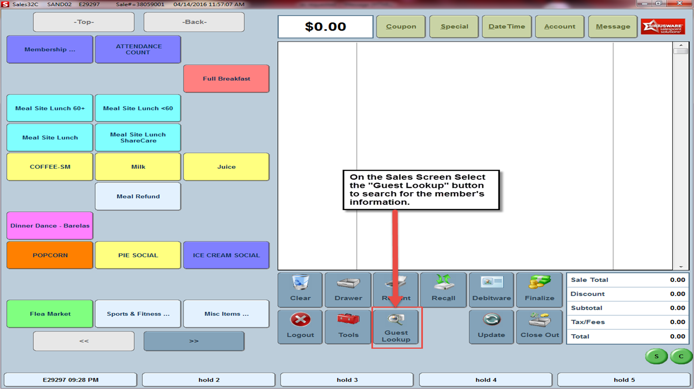
DSA Memberships Course - Section 5 Print/Reprint - Lost/Stolen/Request for New Card/Forgotten Card
Step 1
To begin a Membership Card Reprint: On the sales screen, click the Guest Lookup button to begin to pull up the member’s information.
On the Sales Screen, click the “Guest Lookup” button to search for the member’s information

Slide 4
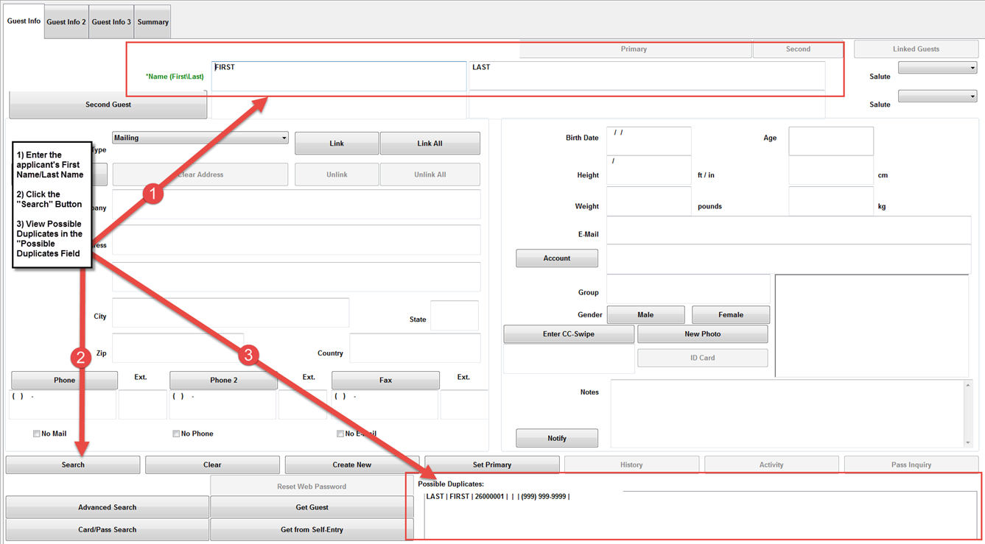
DSA Memberships Course - Section 5 Print/Reprint - Lost/Stolen/Request for New Card/Forgotten Card
Step 2
Enter guest Name>Click the Search button> Check for any duplicates in the Right bottom information box. Ensure there are not duplicates (bottom right of screen). If there are duplicates – ???
If there are duplicates
Enter the applicant’s First Name/Last Name
Click the “Search” button\
View possible duplicates in the “Possible Duplicates field
A
B
C

Slide 5
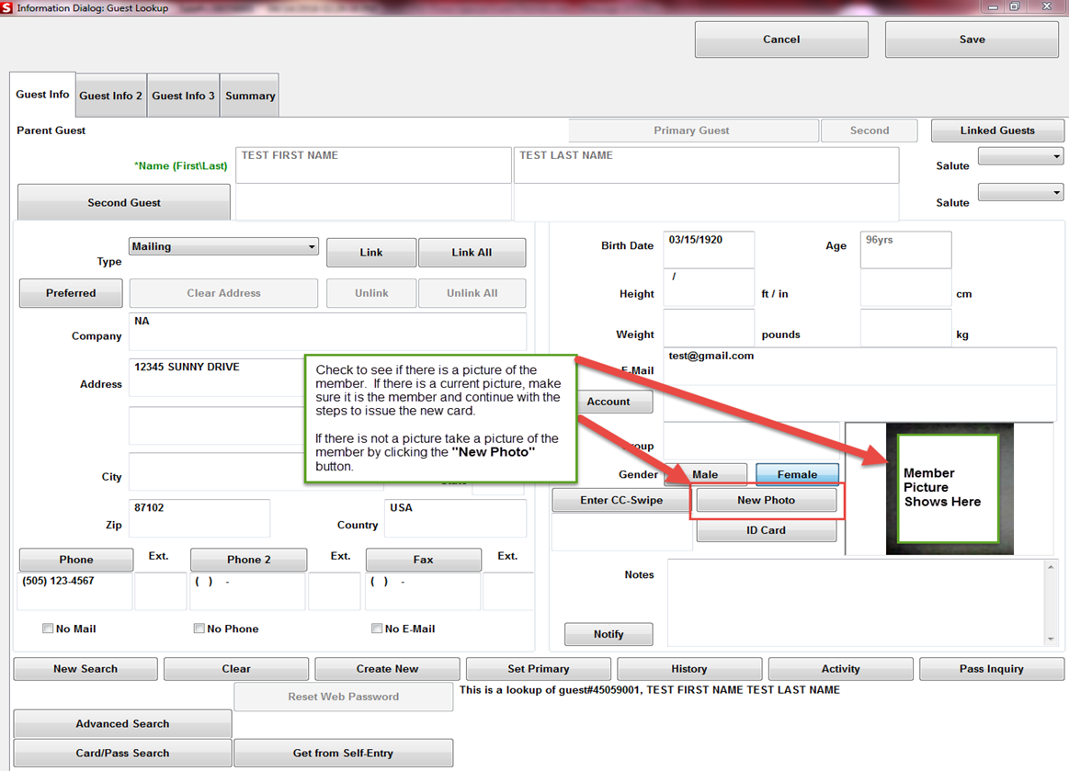
DSA Memberships Course - Section 5 Print/Reprint - Lost/Stolen/Request for New Card/Forgotten Card
Verify Member Picture: Check to verify that the person in front of you is the person in the picture. Take the member’s picture if there is not one in the Point of Sales System. *DSA encourages the member’s picture be on their membership card. If the member refuses to take a picture, take a picture of the center’s logo and place on the card.
Step 3
Check to see if there is a picture of the member. If there is a current picture, make sure it is the member and continue with the steps to issue the new card.
If there is not a picture, take a picture of the member by clicking the “New Photo” button

Slide 6
DSA Memberships Course - Section 5 Print/Reprint - Lost/Stolen/Request for New Card/Forgotten Card
In the “Take a New Photo Window” Click the “Freeze” button to take the member’s picture

Slide 7
DSA Memberships Course - Section 5 Print/Reprint - Lost/Stolen/Request for New Card/Forgotten Card
Click on the Image Area to Resize and Crop the photo. When you are done, click the “Crop and Save” button to save the member’s picture.

Slide 8
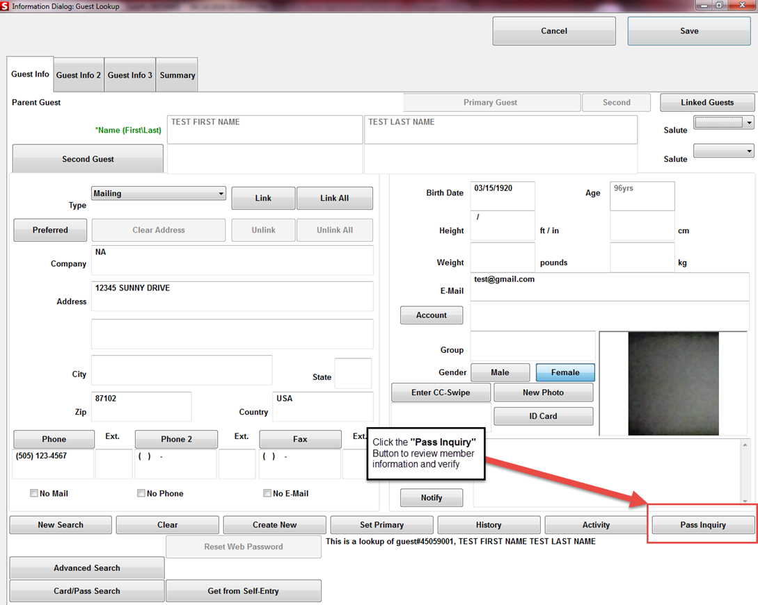
DSA Memberships Course - Section 5 Print/Reprint - Lost/Stolen/Request for New Card/Forgotten Card
Step 6
Click the “Pass Inquiry” button at the bottom right of the sales screen to verify that the member’s membership information is correct.
Click the “Pass Inquiry” button to review and verify member information

Slide 9
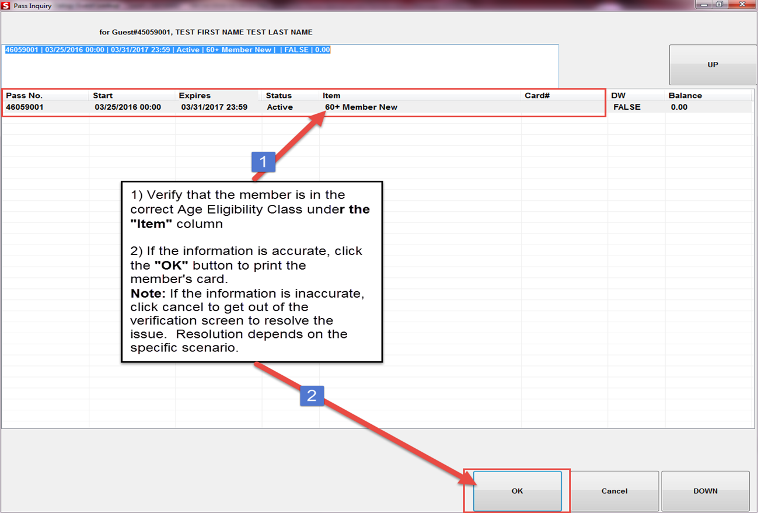
DSA Memberships Course - Section 5 Print/Reprint - Lost/Stolen/Request for New Card/Forgotten Card
Step 7
In the Pass Inquiry Screen, review the membership information to verify that the member is in the correct Age Eligibility Class. When you have verified the member’s information Click the “OK” button.
A
B

Slide 10
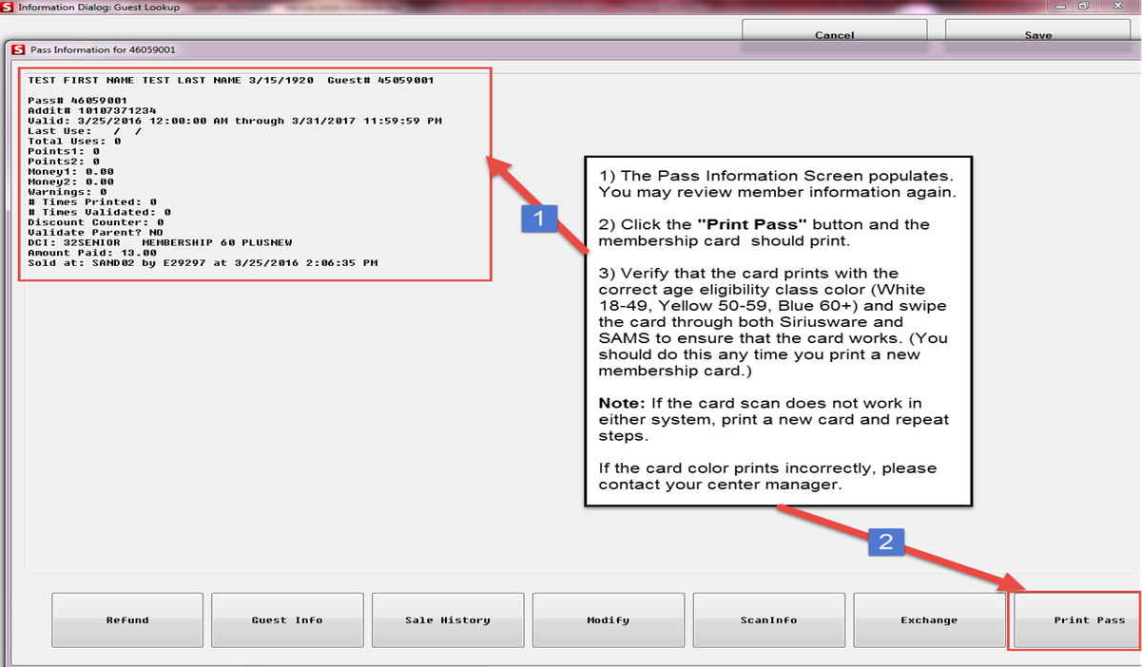
DSA Memberships Course - Section 5 Print/Reprint - Lost/Stolen/Request for New Card/Forgotten Card
Steps 8 & 9
Check the # of times the member’s card has been printed on this screen to see if there will be a fee associated with this reprint transaction.
If everything looks correct, click the “Print Pass” at bottom right of screen.
A
B

Slide 11
DSA Memberships Course - Section 5 Print/Reprint - Lost/Stolen/Request for New Card/Forgotten Card
Step 10
Verify that all of the following accurately printed out on the Membership card:
The correct eligibility class color (White 18-49, Yellow 50-59 or Blue 60+), guest number (generated by the system)
Bar code (created from Addit_No entered by DSA staff)
Member’s picture (taken by you or another DSA staff)
Processing Error: If the membership card prints with the wrong color, please contact your center manager.

Slide 12
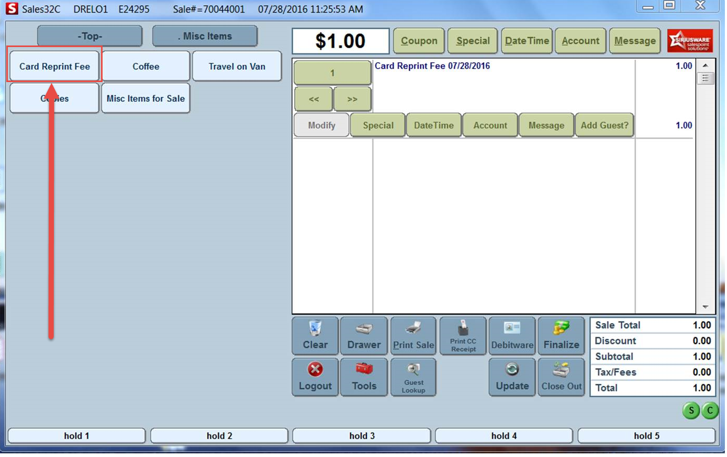
DSA Memberships Course - Section 5 Print/Reprint - Lost/Stolen/Request for New Card/Forgotten Card
Step 11
After you have printed the new card, you will charge a reprint fee as you would process any other transaction.
To apply the $1.00 reprint fee, Swipe the member’s card and click Misc. Items>Card Reprint Fee>Finalize

Slide 13
DSA Memberships Course - Section 5 Print/Reprint - Lost/Stolen/Request for New Card/Forgotten Card
Forgotten Membership Card:
If a member forgets their membership card:
Use “Guest Lookup” to verify the guest’s information (Name, birthdate, address, picture) to process transactions.
Do NOT use the aggregate card.
To scan into the SAMS system, use the paper roster provided by DSA. Each center should have a printout at the front desk.

Slide 14
To begin a search for a guest in the system, click the “Guest Lookup” button.

Slide 15
DSA Memberships Course - Section 5 Print/Reprint - Lost/Stolen/Request for New Card/Forgotten Card
Congratulations! You have completed Section 5- Print/Reprint-Lost/Stolen/Request for New Card/Forgotten Card for the DSA Memberships Course

