Slide 1
Senior Affairs Point of Sale System Memberships Training Course
Section 4
Renewing a DSA Membership
Revised December 28, 2016

Slide 2
DSA Memberships Course -Section 4 Renewing a DSA Membership
When does a member renew a membership?
When a member’s membership has expired
When a member’s membership is about to expire
When is a membership NOT a renewal?
Age Eligibility Group Change:
If a person has moved into a new eligible age class (White to Yellow, Yellow to Blue), you will NOT process this as a renewal. You will create a new membership and print a new membership card. This ensures the correct membership card is printed.
Once you have created a new membership and issued a new membership card for a person who has changed into a new age eligibility class, you will reprint a receipt and stamp it with the Age Update stamp.
Provide the stamped receipt to the manager so that the manager can merge the files and the citizen’s membership expiration date remains the same.

Slide 3
DSA Memberships Course -Section 4 Renewing a DSA Membership
Steps 1 and 2
Overview: When a member’s membership is expired or about to expire and they:
Want to pay and renew and
They are NOT in a new eligibility age class, you will complete the following tasks/steps:
Have the member fill out a SAMS Registration form. (Membership forms must be completed annually.)
Swipe the member’s card through the Point of Sales system to pull up the member’s Information or click on guest lookup to find the member in the system to verify the member’s information is correct.

Slide 4
DSA Memberships Course -Section 4 Renewing a DSA Membership
To begin a search for a guest in the system, click the “Guest Lookup” button

Slide 5
DSA Memberships Course -Section 4 Renewing a DSA Membership

Slide 6
Look for Boomer Exception
There are certain situations where a renewal will not print a card. IF you see the term “Boomer” in the “Item” column:
THEN, you will need to create an entirely new membership in the point of sale system for this member. Steps are on the next page. (you may also refer to section 3 of this course.)
Once you have done completed the transaction, you will add the member information to the log that is kept at the front desk of your DSA facility. Your manager will need to merge these accounts to avoid duplicates within the system.

Slide 7
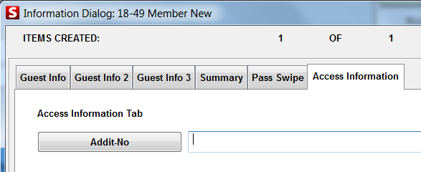
DSA Memberships Course -Section 4 Renewing a DSA Membership
Do a guest lookup on the point of sale system
Record the member’s addit_no and verify the number with the member if possible
Exit guest lookup
Sell a new membership/pass in the appropriate age group
Enter the name of the member to pull up all data
Verify or enter the addit_no in the validation tab
When the sale is completed, the card will print automatically
Test card and deliver card to member

Slide 8
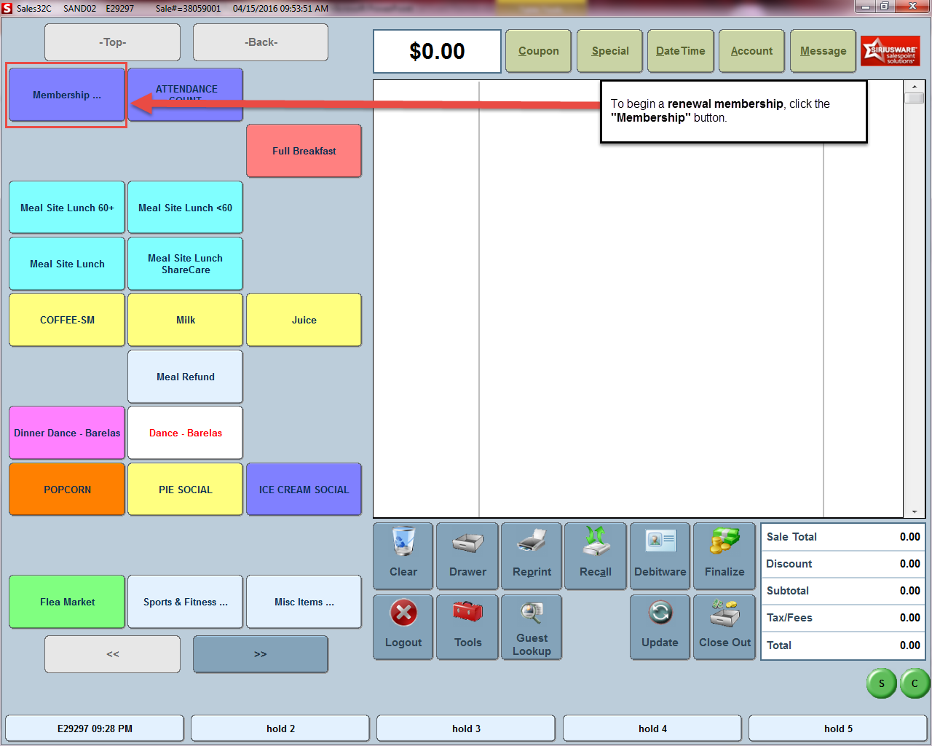
DSA Memberships Course -Section 4 Renewing a DSA Membership
Step 3
From the Main page in the Point of Sales System, Click on the “Membership” button. This will take you to the Membership options page.
To begin a renewal membership, click the “Membership” button

Slide 9
DSA Memberships Course -Section 4 Renewing a DSA Membership
Click the appropriate age eligibility class renewal button. (e.g. 60+ Member Renew, 50-59 Member Renew or 18-49 Member Renew)
Choose the correct renewal age eligibility group: 60+ Renewal, 50-59 Renewal, 18-49 Renewal.

Slide 10
DSA Memberships Course -Section 4 Renewing a DSA Membership
Click the Guest Lookup button on the renewal screen or swipe the member’s card to review the member’s information and renew their membership.

Slide 11
DSA Memberships Course -Section 4 Renewing a DSA Membership
1) Review member information to ensure everything is accurate.
2) Click the Save button to process payment for the membership renewal

Slide 12
DSA Memberships Course -Section 4 Renewing a DSA Membership
1) Accepting a Debit or Credit Card Payment
Swipe credit/debit card while on this screen or if the member is using a cash or check, click the Finalize button.

Slide 13
DSA Memberships Course -Section 4 Renewing a DSA Membership
Enter the amount of payment in the appropriate payment type field (Cash Check, Purchase Order or American Express for the membership transaction.
Click the “OK” button

Slide 14
DSA Memberships Course -Section 4 Renewing a DSA Membership
Test Printed Card: Test the printed card in both the Siriusware and SAMS system card swipe readers to ensure the card works and pulls up the member’s information.
Reprint Card: If the card did not print correctly, reprint and test.
Expiration Date Label: Adhere the new Expiration Date Label to the back of the member’s card and write the new expiration date on the label.
Note: Ensure that the label does not cover or is not near the magnetic stripe as this could potentially cause issues with the scanner.

Slide 15
DSA Memberships Course -Section 4 Renewing a DSA Membership
Congratulations! You have completed Section 4- Renewing a DSA Membership for the DSA Memberships Course

