Slide 1
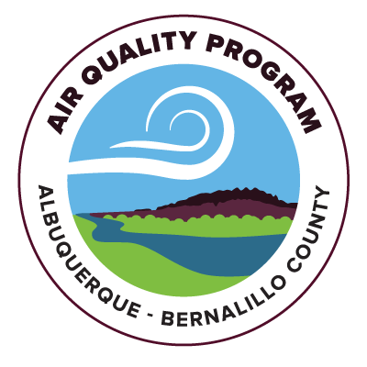
DRAFT Regional Haze SIP element for the second planning period
Presented by Allen Smith
Regulation Development Coordinator
Bandelier Photo Credits: Allen Smith

Slide 2
Regional haze SIP
Overview of Regional Haze SIP
The Clean Air Act (40 CFR 51) requires states (or local jurisdictions within state) to submit plans to US EPA to address visibility impairment in Class 1 Areas…otherwise known as the Regional Haze Rule
Planning is divided into decade long periods, with the goal of achieving “natural visibility conditions” by 2064
Class 1 Areas are national parks over 6,000 acres and wilderness areas over 5,000 acres, as well as national memorial parks (over 5,000 acres) and international parks in existence as of August 1977

Slide 3
BANDELIER

Slide 4
Regional haze SIP
Overview of Regional Haze SIP
Class 1 Areas in NM include Bandelier Wilderness, Bosque Del Apache Wilderness, Carlsbad Caverns National Park, Gila Wilderness, Pecos Wilderness, Salt Creek Wilderness, San Pedro Parks Wilderness, Wheeler Peak Wilderness, and White Mountain Wilderness
Visibility impairment is measured at special monitors in those class 1 areas which measure light extinction. Visibility impairment forms from a variety of sources such as sulfates, nitrates, coarse mass, fine soil, and organic mass from carbon.
The City of Albuquerque Environmental Health Department (EHD) is planning to submit a plan covering Bernalillo County, the regulatory jurisdiction the air program covers, for the second planning period.

Slide 5
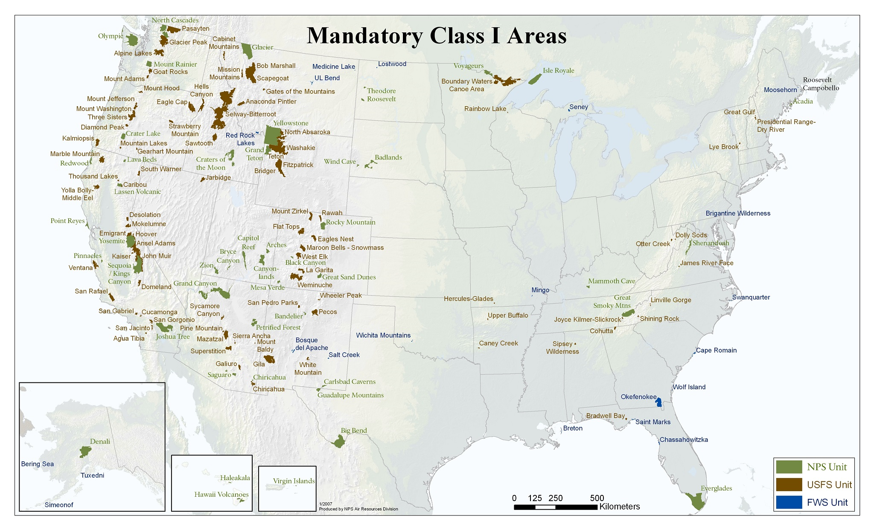
Class I areas

Slide 6
Regional haze SIP
Overview of Regional Haze SIP
EHD collaborated with the New Mexico Environment Department (NMED) on a source selection process for all major sources in the state to determine which facilities would be required to conduct a four factor analysis
The results screened in one facility in Bernalillo County…GCC Rio Grande cement plant in Tijeras
As a result of the four factor analysis and review…it was determined that controls and emission limits would be required for both NOx and SO2, as well as continuous emission monitoring for both of those pollutants

Slide 7
SIP Overview
Overview of Regional Haze SIP
EHD determined that dry sorbent injection (DSI) for SO2 and selective non-catalytic reduction (SNCR) for NOx were cost effective and technically feasible controls at GCC. These controls will be made federally enforceable with appropriate emission limits and a modification of the most recent construction permit to include those requirements.
Modeling scenarios provided by the Western Regional Air Partnership (WRAP) showed most Class 1 Areas on path to achieving natural visibility conditions by 2064, with the exception of Salt Creek Wilderness in SE New Mexico. NMED performed a robust demonstration for that Class 1 Area as required by the rule.
The selected controls were included in the long term strategy for the planning period SIP, as well as a mention of ongoing air quality control programs.
Analysis of impacts from Bernalillo County to neighboring states, particularly Southern Colorado, showed minimal impact on those areas.

Slide 8
Regional haze SIP
Stakeholder Outreach
The draft plan is available for public comment for 30 days prior to hearing in front of the Air Quality Control Board.
EHD collaborated closely with NMED throughout the planning for this SIP element, and also worked closely with the US EPA, Region 6.
EHD also held numerous meetings with the regulated facility, GCC, to obtain as much information as possible to make informed policy decisions for this SIP.
EHD recently completed a formal 60 day review period with the federal land managers who manage the Class 1 Areas in New Mexico. Those agencies are the National Park Service, the Forest Service, and the Fish & Wildlife Service.
EHD sent a draft to states surrounding New Mexico, as well as NMED.
NMED sent a letter to all tribal leaders in New Mexico at the end of June seeking any tribal input on the draft SIP element.

Slide 9
Public comment
Public Comment
EHD began the public comment period on July 30, 2024. The draft Regional Haze SIP Element, along with associated exhibits, are available at https://www.cabq.gov/airquality/air-quality-control-board.
The 30 day public comment period will comply with requirements under NMSA 1978 74-2-6(C) and 40 CFR 51.102(A).
Comments may be submitted electronically to Allen Smith, Regulation Development Coordinator, at morgansmith@cabq.gov.
In addition to this public input session, EHD will be hosting a virtual only public input session on August 6, 2024 from 4:30pm to 6:30pm. Information on the session is located at https://www.cabq.gov/airquality/regulation-development/public-notices-and-comment-opportunities.

Slide 10
Bandelier

Slide 11
Bandelier

Slide 12
Questions?

